Slide 1
Association of Professional Energy Consultants
APEC – Southern Illinois
February 11, 2022
  Community Energy Systems: Tools of Economic Development
  Tim Michels
  Energy Resources Group, Inc.
  6744 Olive Boulevard
  University City, MO 63130
  314.644.0000

Slide 2
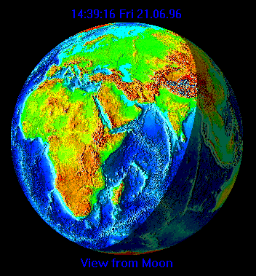
THIS IS WHY WE DO IT
Spaceship Earth
We Need to Protect Spaceship Earth for the 7th Generation

Slide 3
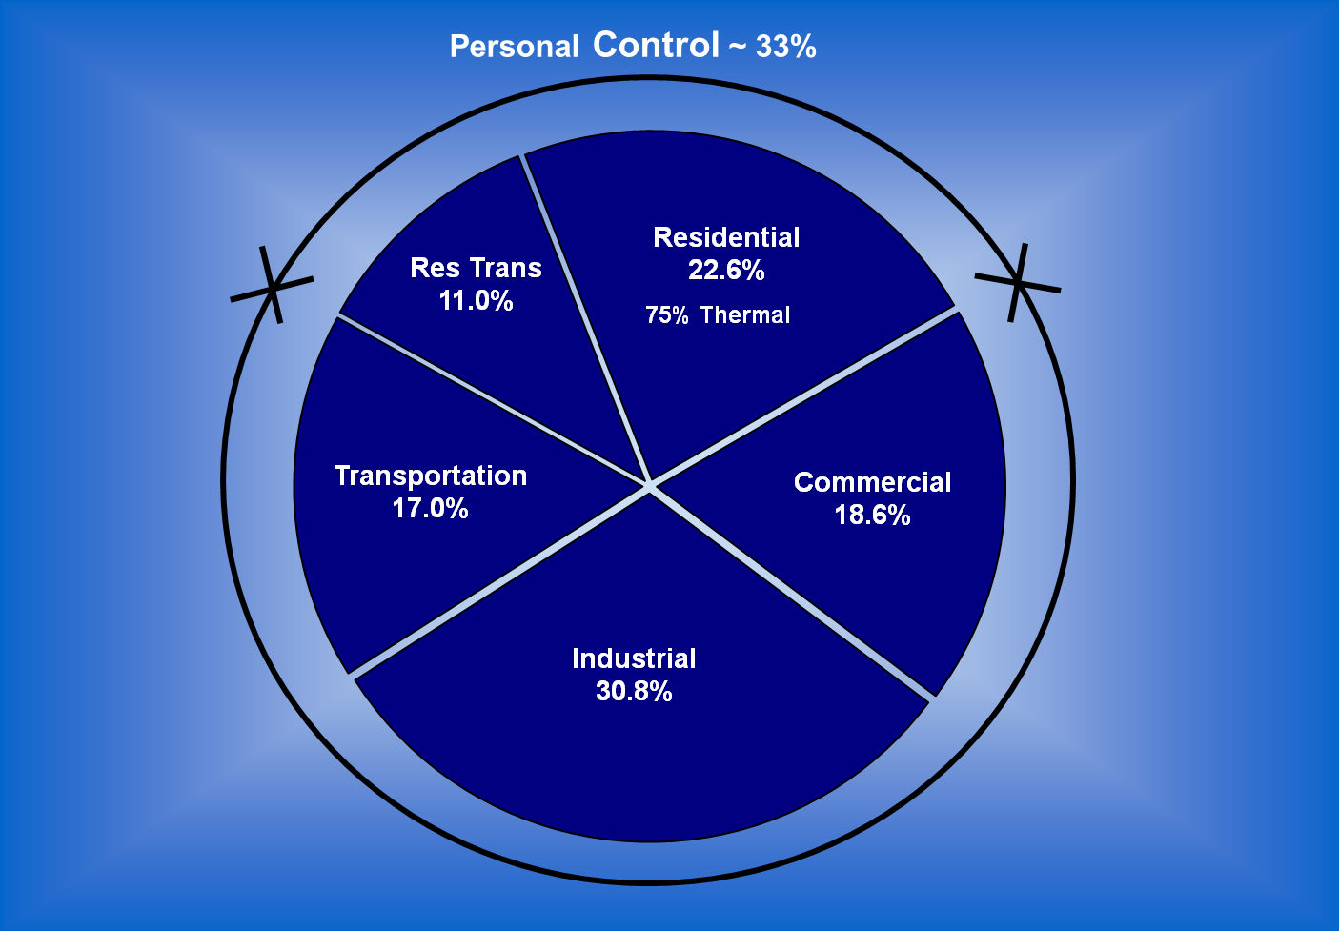
USA Energy Sectors (Control)
Personal Control = 30%
(75% Heat)
Paradigm 1: We have no control what can we do?
New Paradigm 1: No, We Have True Control
Notes:
Paradigm 1: We have no Control
Y:\04 ENS Energy\Energy\Resources\EIA Data\::Personal Control 2010

Slide 4
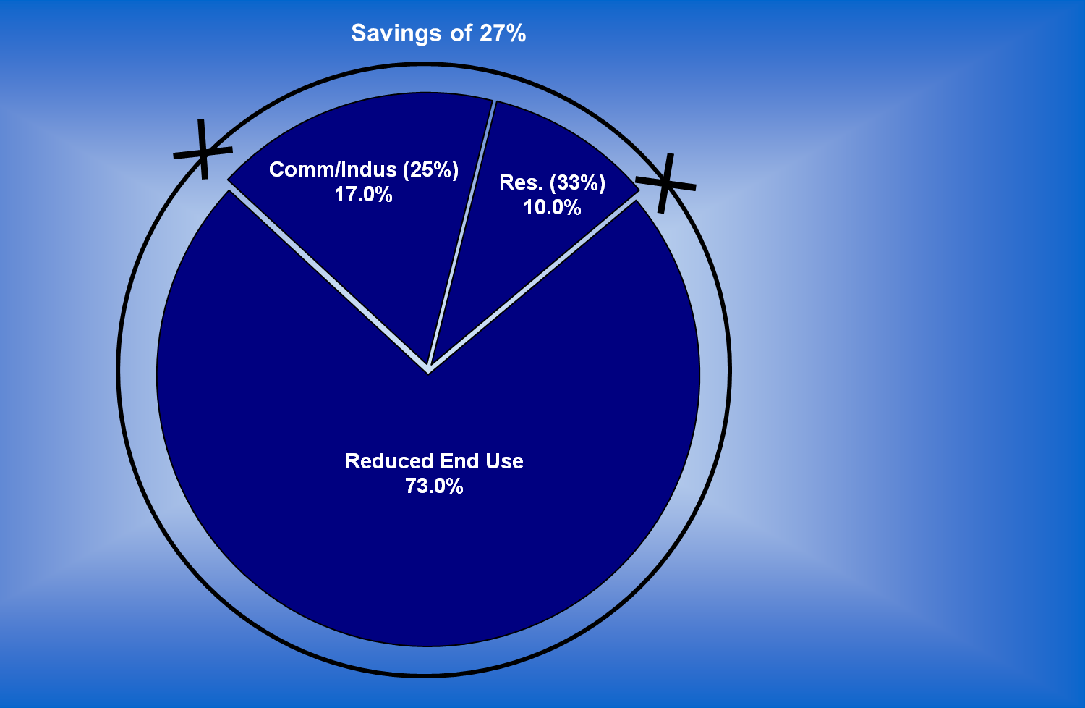
Energy Efficiency Benefits
Cost Effective
3 Yr. Payback
for Business
6 Yr. Payback
for Individuals
Reinvestment
$3.0+ Trillion
30 MM Job Yrs.
10 Yr. Program
Trade Balance
No Net Energy
Imports
Net Export of 17%
Paradigm 2: Energy Savings means Suffering & Pain?
New Paradigm 2: Invest in yourselves with high ROIs.
Notes:
40+ years of experience leads to knowing that we don’t need new technology to work ourselves out of the mess we are in. Doing just what is cost effective at today’s cost of energy is a $2Trillion market opportunity in the USA. As a society, we need to be doubling down on this bet. It doesn’t look this will happen through DC, because the “Supply Side” legacy of the Reagan era is on ascendency again. It’s hard to understand this bankrupt approach, since it doesn’t look like we will be swimming in more oil than we know what to do with any time soon. So, it will be up to us, the little people, to make this happen at the grass roots.
It is typical for us to secure 25% savings on projects with 4-5 year payback. Much of industry is seeing 15-20% reduction with a less than 2 year payback. This chart shows that USA society as a whole can reduce energy usage 27% with an average payback of 4 years – blending 3 year business with 6 year individual payback time lines.
What does this mean? It means that each of us at all levels of government: tribal council, city, county, state, school boards, etc., need to get the word out that there are truly very quick pay backs in finding energy waste and eliminating it. I have defined cost effective as a 3 year payback for business and industry and six years for individuals and institutions (non profit sector). You and I, as individuals, pay for energy with after tax dollars, so they are expensive dollars. Investing in ourselves to reduce our energy bills will make a big difference in our individual cash flows. Where else can you invest money and get a 16+% after tax return on investment.
The collective impact of doing this is that we generate 2.5 million jobs that will be sustainable for at least 10 years as we take the first steps toward making this economy less energy wasteful. Remember, this is just waste we are attacking and we don’t have to wait for any new technology. This market will only get more robust and sustainable as energy costs continue to rise, which they will. This is an economic development dream. We just have to do it. This will bring unemployment down 2% by generating meaningful jobs, significantly reduce our trade imbalance and have us swing from net importers of energy to net exporters of energy. Yes we will still probably be importing oil, but much less of it, and our overall energy security will be enhanced as we export more of the energy we produce domestically.
Remember, no new technology, very positive returns on investment, Jobs, Jobs, Jobs.

Slide 5
Paradigm 3: We have to use more energy to sustain economic growth.

Slide 6
New Paradigm 3: Economic Growth readily decoupled from energy use. More Efficiency, Less Waste.
Notes:
https://www.eia.gov/totalenergy/data/flow-graphs/total-energy.php
Z:\Resources\EIA\Table_1.1_Primary_Energy_Overview_v2.xlsx

Slide 7
WHERE COULD WE BE?
25% Savings
Payback ≤ 4 years
~ Business ROI

Slide 8
WHERE COULD WE BE?
~ Institutional ROI
Governmental

Slide 9
WHERE COULD WE BE?
This is a guaranteed return on investment of > 12+% - DAY 1!

Slide 10
₁₉₆₇

Slide 11
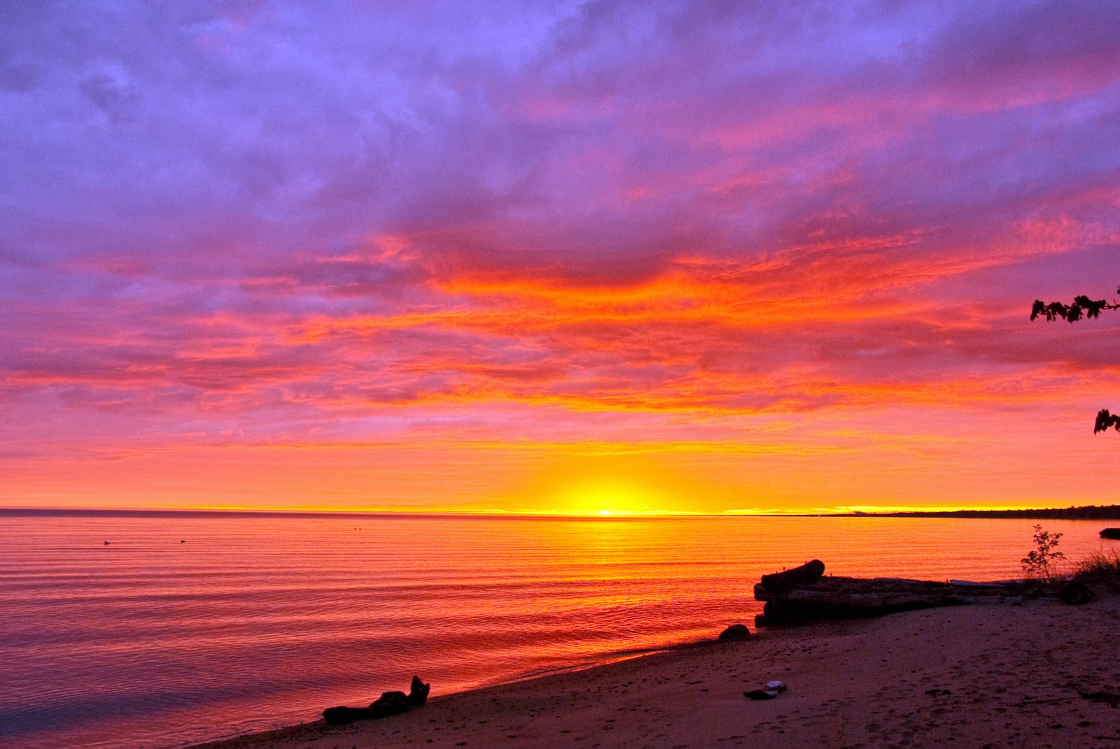

Slide 12
Renewable Energy Future

Slide 13
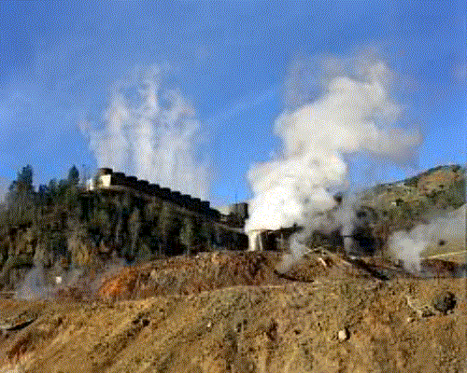
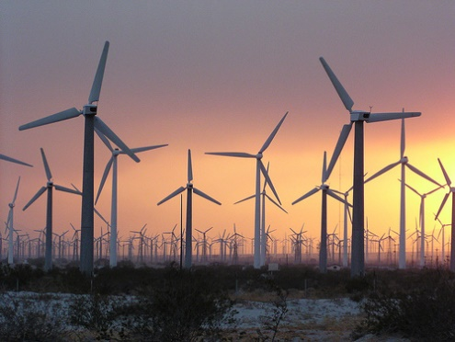


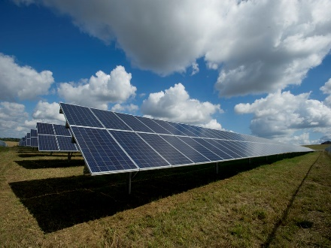
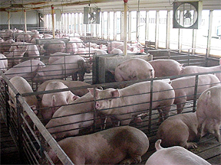
Renewables
Geothermal
Wind
Hydro
Biomass
Solar
Animal Waste/All Waste

Slide 14
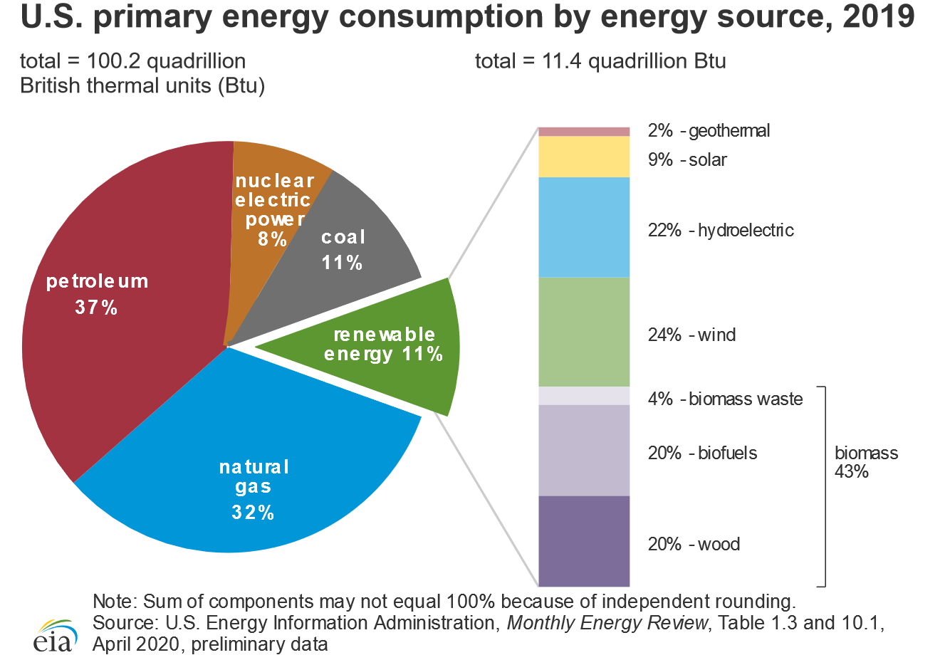
14
Notes:
Renewables have now reached the level of coal usage. But further note that 43% of renewables (Biomass) is still carbon based but is considered carbon neutral. However, this carbon neutral status only remains as long as we replace the harvested biomass with new plant growth. This has to be managed.
https://ourworldindata.org/renewable-energy#how-much-of-our-primary-energy-comes-from-renewables
In 2019, around 11% of global primary energy came from renewable technologies.

Slide 15
EIA Renewable Energy Economic Forecasts
1
Dispatchable
Renewable Energy
Dispatchable
Storage is part of this Future
Flywheels
Batteries
Fuel Cells
1
$/MWh
Notes:
I am showing you a market evaluation done by the EIA in 2015 that projected what they thought the cost of electricity would be for an array of renewable energies along with the conventional carbon-based power generation technologies in 2020. The comparison was based on the levelized cost of electricity , which is based on the expected average cost of electricity over the plant's useful life. The array of options was compared to “conventional coal” which costs $95 per MWh, or 9.5 cents per kWh. Wind was already judge less expensive, but solar PV was more expensive.

Slide 16
EIA 2015
for 2020
$73.6
$125.3
Adv NG $72.6
Coal $95.1
Notes:
In 2018, Deloitte published an analysis of Global Renewable energy trends looking primarily at wind and solar pv. Wind ranged from $30-60/MWh, Solar ranged from $43-53 MWh and conventional generation ranged from $42-78/MWh. This slide lays the EIA 2015 projections over the scale. This slide is not meant to show how far off the mark EIA was only three years later, but to underscore the fact that the market moved faster than was expected to deliver lower renewable energy costs.

Slide 17
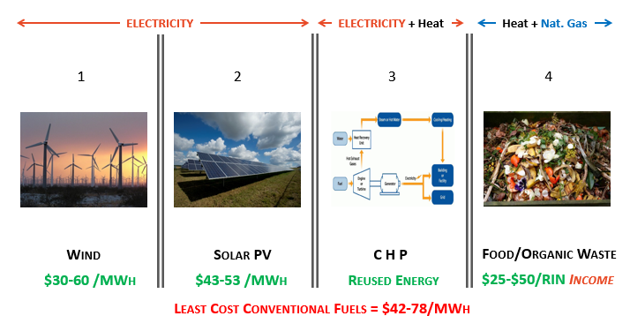
Viable Renewable Opportunities
*
Combined Heat & Power
Combined Heat and Power
*
https://www2.deloitte.com/insights/us/en/industry/power-and-utilities/global-renewable-energy-trends.html
Notes:
This slide just wants to ask that all of us consider additional renewable energy opportunities that are also market ready but don’t get much play. They come from what are thought to be waste streams and are less sexy. Lots of industrial facilities use natural gas for process heating. Most of this energy is wasted on a once through pass and then is up the stack. If this energy was first used to make electricity, the heat leftover from this first step could still provide the process heat needed. This is a combined heat and power opportunity that is significantly more efficient. The trash and garbage we pay to have landfilled can be burned to make electricity while it reduces landfill costs 90%. So, as part of the solution sets, lets make it a priority to not waste these valuable resources.

Slide 18

Getting to “Climate Economy” Solutions

Slide 19


Integrative Design with a Systems Approach
Wide Perspectives / Broad Points of
view are critical for problem solving
  Everyone has a valid and valuable
  point of view
Encourage disruptive thinking
  We can’t do it the same way it has
  always been done
  Siloed approaches are not more efficient
  Need to eliminate a silo approach
  to the world
Follow the example of nature – there
is no such thing as waste
  Outputs from one system are necessary
  inputs to another one.
First Cost
Energy Cost
Maint. Cost
Life Cycle Cost
EPA
USDA
DOE
DHUD
Town/City
County
State
Federal
Paradigm 4: Siloed Thinking Is Needed to Foster Efficiency
New Paradigm 4: Pursue Integrative Designs – In Nature Everything is Interwoven.
Notes:
There are a plethora of systems out there that try to do one thing in isolation well. The problem is that none of these things can be done well if their various relationships with other functioning systems/processes are not properly addressed in an integrated fashion. We have been clinging to the ways things have been done in a siloed approach.

Slide 20
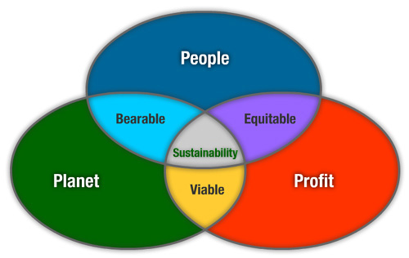
Foundation and Goals
To start, establish a rigorous Energy Investment Policy; eliminate siloed thinking; and promote integrative design solutions that meet the test of being restorative.
Create meaningful green jobs in distressed communities that bear the brunt of environmental and economic injustice.
Focus on Triple Bottom Line solutions that benefit People and the Planet while generating Profit.
Leverage the basic cashflow streams of all communities as economic impetus for solving the daily problems they face. Their existing costs for food, energy, housing, transportation, and waste disposal generate sufficient cashflow velocity that communities can produce jobs that:
    improve building energy efficiency and own/produce your energy,
    grow healthy, local foods to eliminate local food deserts,
    turn waste streams into energy, products, and recovered nutrients,
    manufacture, build, and maintain your own homes.
  All this leads to more self-sufficient communities on paths to Net-Zero CO₂ production with >10% ROI
  Think! Community Energy Systems!

Slide 21
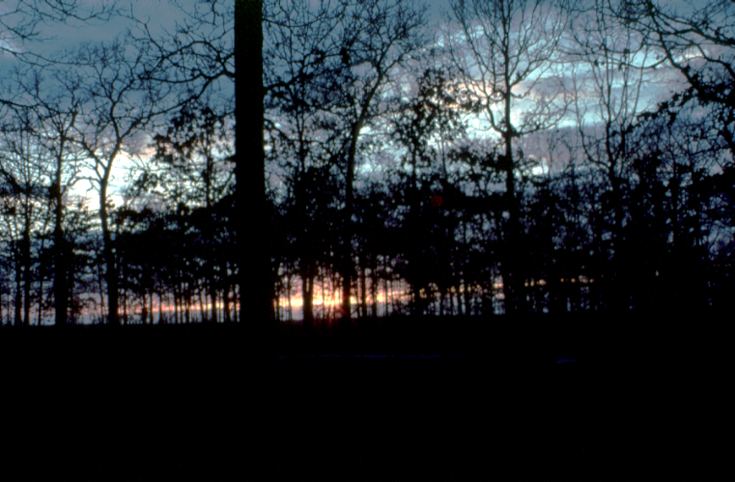

Slide 22
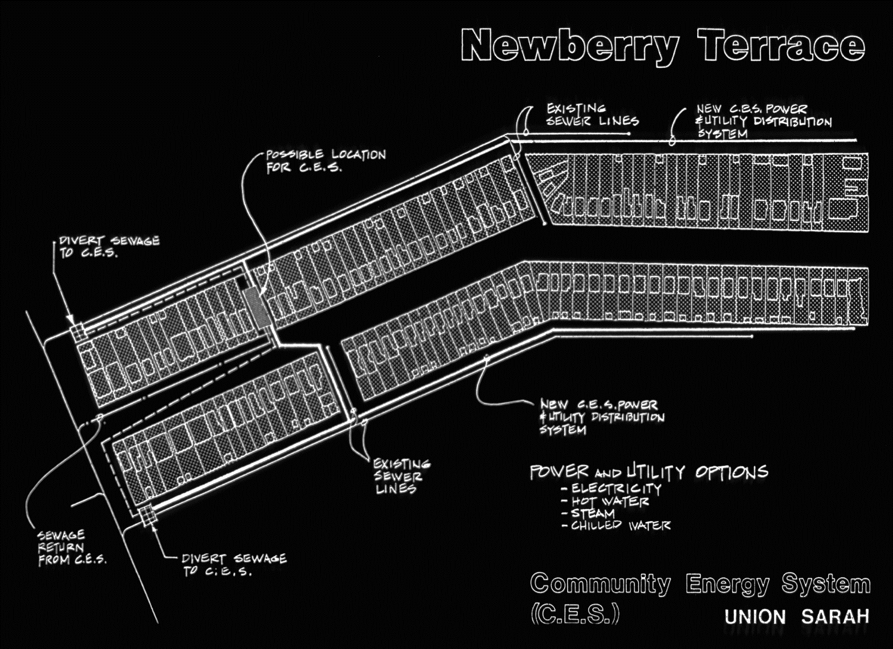
CES Model Applied (1981)
Newberry Terrace
Analyzed Usage for 168 DU
Remodel:
  To Reduce Usage – saves 50%
  For Passive Solar – Saves 20%
Redirecting Wastes costs:
  Sewage
  Biomass
  Trash/Garbage
Est. ROI was 3-5%
More cost effective in 2020 just with adding Solar PV
Community Energy System
(CES)

Slide 23
Community Energy Systems (CES)
Site Based Energy
Processing / Interconversion
Storage
Loads
Nat. Gas
Sewage
Methane
Digestor
Nat. Gas
Cooking
Heating
Biomass
Alcohol
Fermenting
Engine
Gen.
Fuel
Cell
Thermal
Engine
Chiller
Thermal
COLD
Chilled
Water
Trash
Garbage
Compost
HEAT
Hot Water
Pyrolysis
GeoThm
GSHP
ACES
Snow
Passive
Thermal
Heating
Solar
Photo-
Voltaics
Electrical
Battery
Power
Wind
Wind
Generator
Grid Power

Slide 24
Ag. Based Community Energy System
Chicken
Hydrothermal Liquefaction

Slide 25
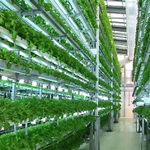
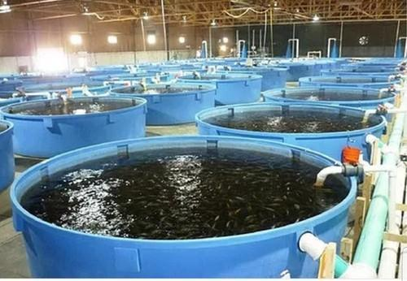
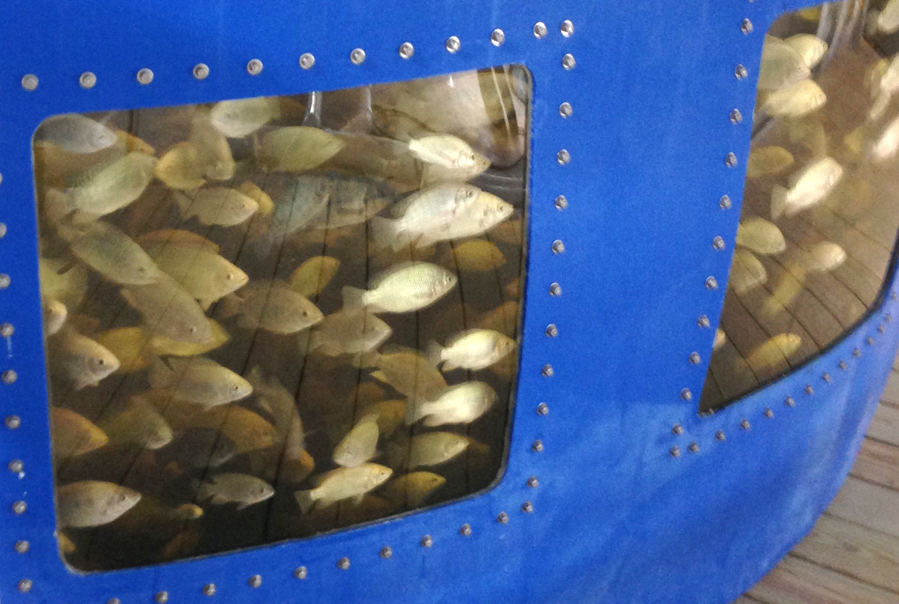
High Tech Green Ag Opportunities
Hydro- and Aero- ponics
Aquaculture

Slide 26
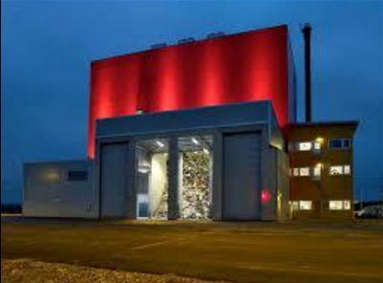
Waste to Energy: Combined Heat & Power
75+ Large USA WTE plants
  Municipal Solid Waste (MSW)
  Ind. Biomass/Yardwaste
  Reduce Landfill 90%
  Environmental Justice Plus
  Generates Power, Heat, RECs
170+ Smaller European WTE
  Sweden: Cannot landfill any organic waste
  Distributed Community Scale
Anaerobic Digester/RNG
  Inputs
    Sewage
    CAFO Animal Waste
  Outputs
    Nutrient Recovery
    Co-Products
CHP Plant, Skövde, Sweden

Slide 27
  Job Creation Opportunities
Renewable “Green” Energy Production
  Solar - Photovoltaics
  Solar – Thermal
  Wind
  Biomass Conversion
  Methane / CNG Production
  Geothermal power production
  Low Head Hydro
  Algae production (fuel)
  CO₂ capture for green houses
  Electrical Storage
Energy Efficiency Related: Construction
  Ground Source Heat Pump Install
  Compressed Earthen Block Homes
  Insulated Concrete Homes
  Building Energy Efficiency
    Energy Audits
    Building Energy Retrofits
    Heating and Air Conditioning
    Lighting
    Domestic Hot Water
    Refrigeration
    Controls

Slide 28
  Job Creation Opportunities
Salvage and Remediation
  Recycling
  Tire Recovery
  Paint Recycling
  Environmental Clean up
  CAFO waste processing
“Green” Farming - Food Related Production
  Organic Vegetables/Fruits/Grains
  Aquaculture
  Small/Large Animal Husbandry
  Bee Keeping
  Hydroponics
  Mushrooms/Escargot
  Algae production (food)
  Permaculture
  Floral Production
Waste Water/Sewage to Biomethane
  CAFO waste processing
  Municipal Sewage
  Municipal Refuse
  Residential Septic Systems
Landscaping
  Soils
  Composting
  Vermiculture
  Nursery Production
  Community Gardens
Other “Green” Jobs
  Compressed Earthen Blocks

Slide 29


Slide 30
How to start:
Develop an Energy Investment Policy to define “cost effective”
based on:
      Energy Costs
      Maintenance Costs
      Life Cycle Replacement Costs
      Useful life of the equipment/building
      Cost of CO₂ Emissions
      Cost of Money
Develop a Master Plan of Attack – Save and Produce Energy
Find the Money

Slide 31
Develop a Master Plan of Attack - Save Energy
Bring Energy Efficiency to Buildings and Processes
  Buildings use 40 % of the energy in the USA.
  Building energy efficiency is well understood.
  Buildings last a long time, so the investments are
  likely to pay for themselves over time.
  Large, available inventory awaiting improvement
    Homes
    Businesses and Industries
  Stimulates and sustains significant jobs
    Professional
    Construction
    Financial

Slide 32
Develop a Master Plan of Attack – Make Energy
Develop local renewable energy industries
  Direct Renewable Energy:
    Wind
    Solar
  Indirect Renewable Energy:
    Ground Source Heat Pumps
    Wastewater (City and CAFO) to Methane
    Landfill Gas Recovery
  Co-Product Market Opportunities:
    Manufacturing Support
    Recovered Heat
    Compressed/Liquifide Natural Gas

Slide 33

Economics of a Residential Case Study
33
Notes:
Let’s take a look

Slide 34
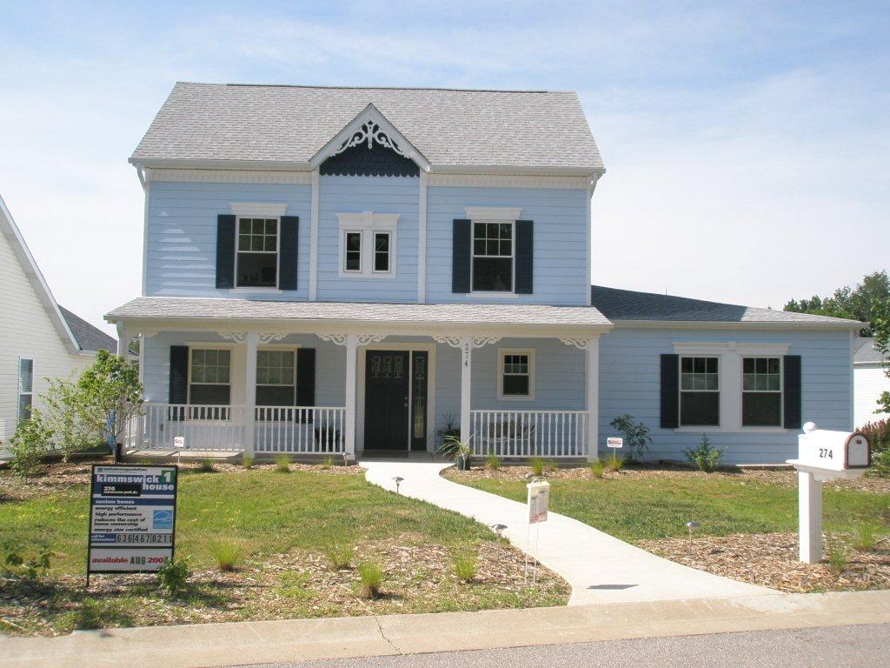
K-1 274 Montesano Park Drive
Net Zero Ready Home (NZR)
Notes:
To examine how cost effective this can be we will start with Residential, since most of us are familiar with homes and their systems. This is the Kimmswick home that Jordan Heiman and I built to demonstrate what can be done.
It is a 3000 SF, all electric home designed with Passive Solar features.

Slide 35
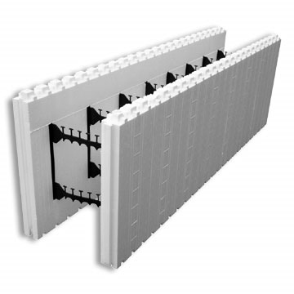
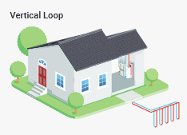
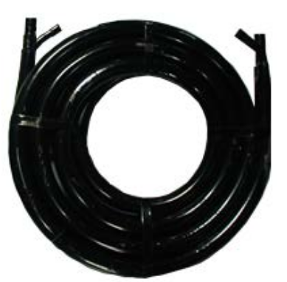
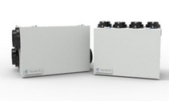

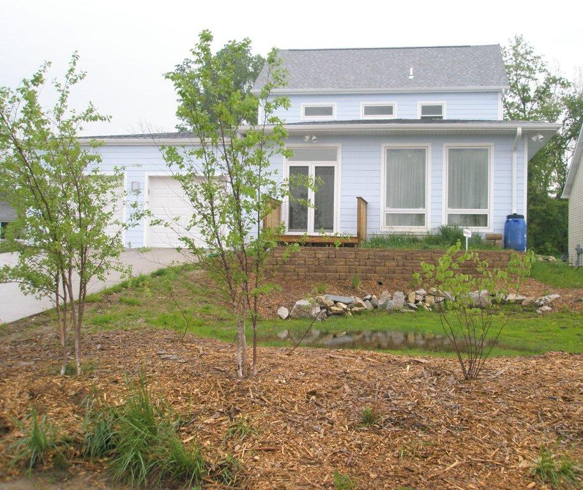

274 Montesano Park Drive
Sustainability Features
Insulated Concrete Forms (ICF) (R_{eff} = 40+)
Ground Source Heat Pump (GSHP)
Desuperheater = 2/3 DHW from Cooling Heat Recovery
Central ERV - Toilet Exhaust (50+% Savings)
Passive Solar Design Features
Vacancy Sensor Light Switches
100% Compact Fluorescent Lighting
Use LEDs now
Notes:
The sustainable features implemented that were state of the art in 2007 were
The poured concrete house was so air-tight that it we installed and ERV to keep the air fresh

Slide 36
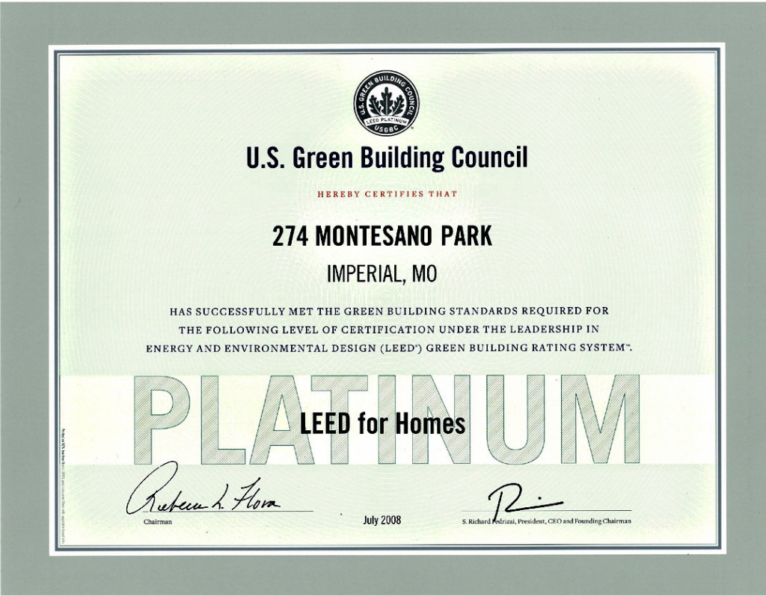
LEED Platinum
Rated at Energy Star 5+ .

Slide 37
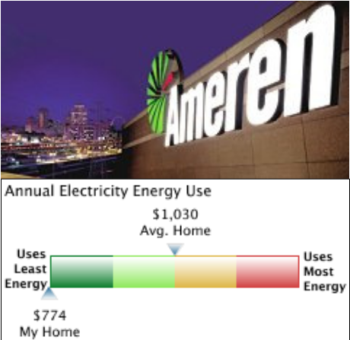
274 Montesano Park Drive
$65/Month (2007)
25% Less than Average Home
Notes:
Ameren helped validate our efficiency benefits.

Slide 38
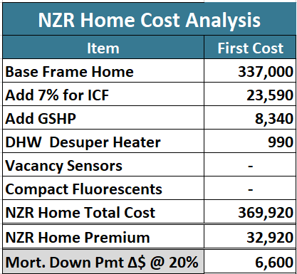
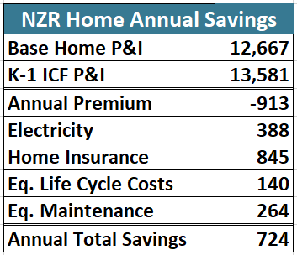
But Does it Pay?
Cashflow Positive Day !!
Notes:
30-year benefit $$15,000+. At an average of $724/year
https://ergi.sharepoint.com/sites/ERG/Shared%20Documents/Current%20Projects/USGBC/Calcs%20for%20presentation%20201203.xlsx?web=1:: K-1

Slide 39
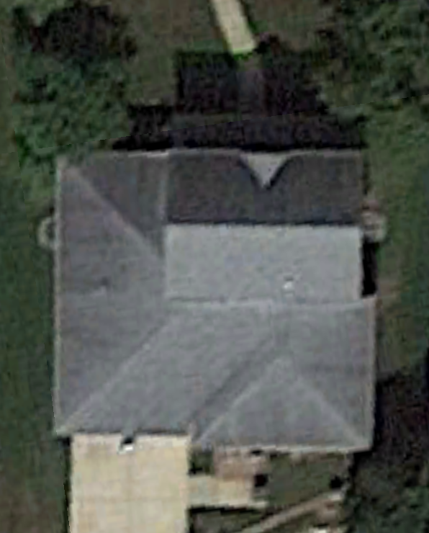
K-1 Solar Analyses
6.5 kW
2.5 kW
Ameren MO
Ameren IL
Notes:
https://ergi.sharepoint.com/sites/ERG/Shared%20Documents/Current%20Projects/USGBC/Calcs%20for%20presentation%20201203.xlsx?web=1 :: Solar Calcs
Note that there is value in going to the 9kW so that the site can be Net Zero without investing in sequestration options or buying RECs that may be more costly.

Slide 40


Find the Money: Efficiency
Train local talent to perform energy audits.
Home Ownership Loans (502)
Home Repair Loans & Grants (504)
Rural Rental Housing Loans (515)
Housing Revitalization (514-516)
Self Help TA Loans and Grants
Housing Preservation Grants
Bus. & Ind. Guaranteed Loans
Rural Business Development Grants
Intermediary Relending Program
Rural Eco. Dev. Loans and Grants
Rural Energy for America Program
Community Program Loans & Grants
Do energy audits for Homes & Businesses.
Hire local companies and businesses to implement audits implementation:
  Lighting
  Repairs/Insulation
  Windows
  HVAC
Time & Scope grow
Start/sustain businesses to deliver needed efficiency equipment and services.
Expand the base of skills and services offered (E.g., GSHP).
Take it to a community scale

Slide 41
Find the Money: Renewable Energy
Help businesses build, own, and operate Solar and Wind Farms.
Help businesses build own, and operate Anaerobic Digester & C/LNG systems
Work with businesses and industry to build own, and operate CHP Systems.
Solid Waste Management Grants
Water & Wastewater Disposal
Bus. & Ind. Guaranteed Loans
Rural Business Development Grants
Intermediary Relending Program
Rural Eco. Dev. Loans and Grants
Rural Energy for America Program
Time & Scope grow
Help businesses build own, and operate Co-product recovery systems
Reach out to depressed communities – then deliver economic justice
Take it to a community scale

Slide 42
Find the Money: Efficiency and Renewables
Let’s sweeten the pot some more!
Incentives, Rebates, and Grants
  Ameren – Electric Incentives and Natural Gas Rebates
  Illinois EPA Energy Efficiency Trust Fund
  Monroe County Elec. Coop. – Audits, Rebates
  Southern Illinois Elec. Coop – Evaluation tools for Home and Business
Future Energy Jobs Act (FEJA)
Clean Energy Jobs Act (CEJA)
Federal Tax Credits
Federal Tax Deductions (Accelerated Depreciation)

Slide 43
Find the Money: Renewable Energy
The USDA is prominent here because of their specific mandate to support rural economic development
The EPA and DOE have opportunities as well.
Don’t Forget the Small Business Administration!
I have it on good authority that the SBA has programs and funding that rival those of the USDA.
These slides underscore that there are many ways to skin the capital cat.

Slide 44
Move Beyond Energy!
It is Community Economic Development:
There are many Cashflow Streams that can be leveraged
Housing Energy Improvement Costs
  Low – Moderate Income Assistance Programs
  Community Action Agencies (CAA)
  Property Assessed Clean Energy (PACE)
  Conventional Mortgages
Energy Costs
  Electricity
  Natural Gas
  Water
Food Costs
  Organic Field Crops
  Small Animal Husbandry
  Hydroponic Vegetables
  Aquaculture
Waste Disposal Cost
  Sewage
  Garbage
  Trash
Notes:
We are not in this alone

Slide 45

It is Community Economic Development:
There are many Partners
Educational Institutions
  Community Colleges
  Trade Schools
  Universities
Governmental
  Towns
  Counties
  State
  Federal
Private Sector
  Businesses
  Not-For-Profits
  Individuals
All of us are Part of the Crew:
Notes:
We are not in this alone

Slide 46
Partnering is Pivotal to Success:
Partners support these efforts with:
  “Incubator Services”
    Entrepreneurial training
    Grant production skills
    Loan application assistance with SBA/USDA/EPA
    Accounting support for enterprises
  Financing Services
    Brokerage for Public Private Partnerships (PPP) that will leverage tax benefits
    Loan/Lease negotiations with third parties
    Relending from USDA programs
  Marketing/Branding
    Develop product specific marketing cooperatives
    Promote “green/eco” brand(s)
  Training
    Construction skills
    Operating and maintenance skills
    Manufacturing and plant production skills

Slide 47
The Final Challenge is to Be Restorative
Together, as one of the more polluting societies on Space Ship Earth, we have to get beyond “Net Zero Energy” we have to arrive at a state of being that is “Restorative”.
Everything we touch or use in any fashion from the natural environment (air, water, land, etc.,) needs to be returned to the environment in better shape than when we withdrew it. Every withdrawal needs to be matched with an equal or greater deposit. It is the only way we will be able to provide a sustainable future into the 7th generation.

Slide 48

IT IS IN OUR HANDS
IT IS UP TO US

Slide 49
Association of Professional Energy Consultants
APEC – Southern Illinois
February 11, 2022
  Community Energy Systems:
  Tools of Economic Development
  Tim Michels
  Energy Resources Group, Inc.
  6744 Olive Boulevard
  University City, MO 63130
  314.644.0000

