Slide 1
RESOURCES FOR ELECTRIFYING FLEETS
Dr. Joy Piazza
Industry & Community Relations Director
Illinois Alliance for Clean Transportation
Il-act.org
jpiazza@il-act.org
301.447.0898 (Southern Illinois Region)
September 22, 2023

Slide 2
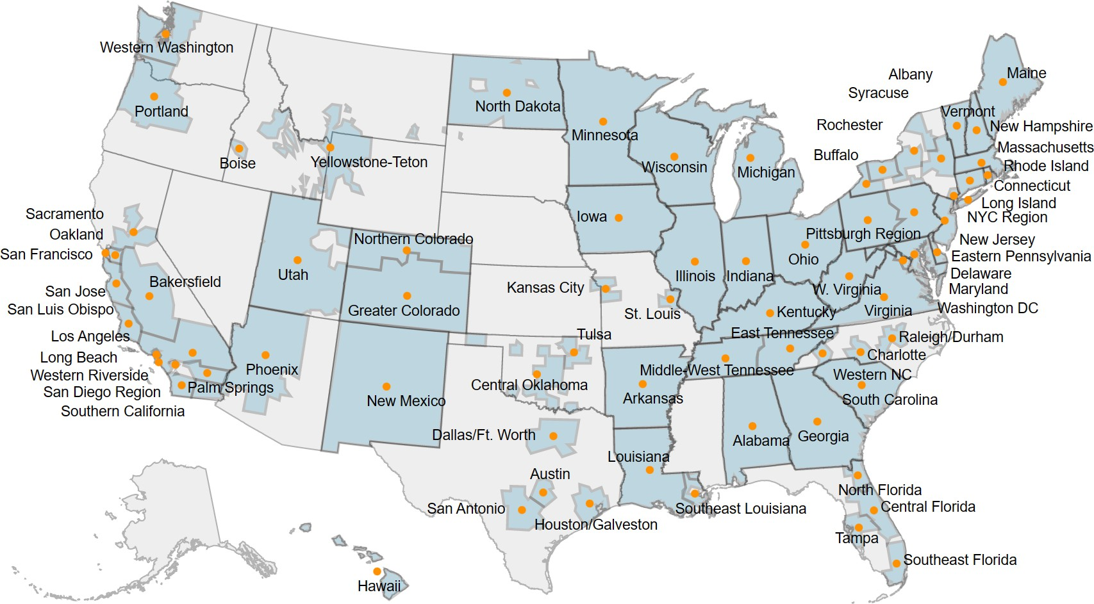
National Department of Energy Network of Clean Cities Coalitions
Clean Cities Coalitions
More than 75 active coalitions covering nearly every state with thousands of stakeholders
cleancities.energy.gov
Fuel-neutral
to help their stakeholders identify cost-effective solutions that
Clean Cities Coalition Network | 2
work locally

Slide 3
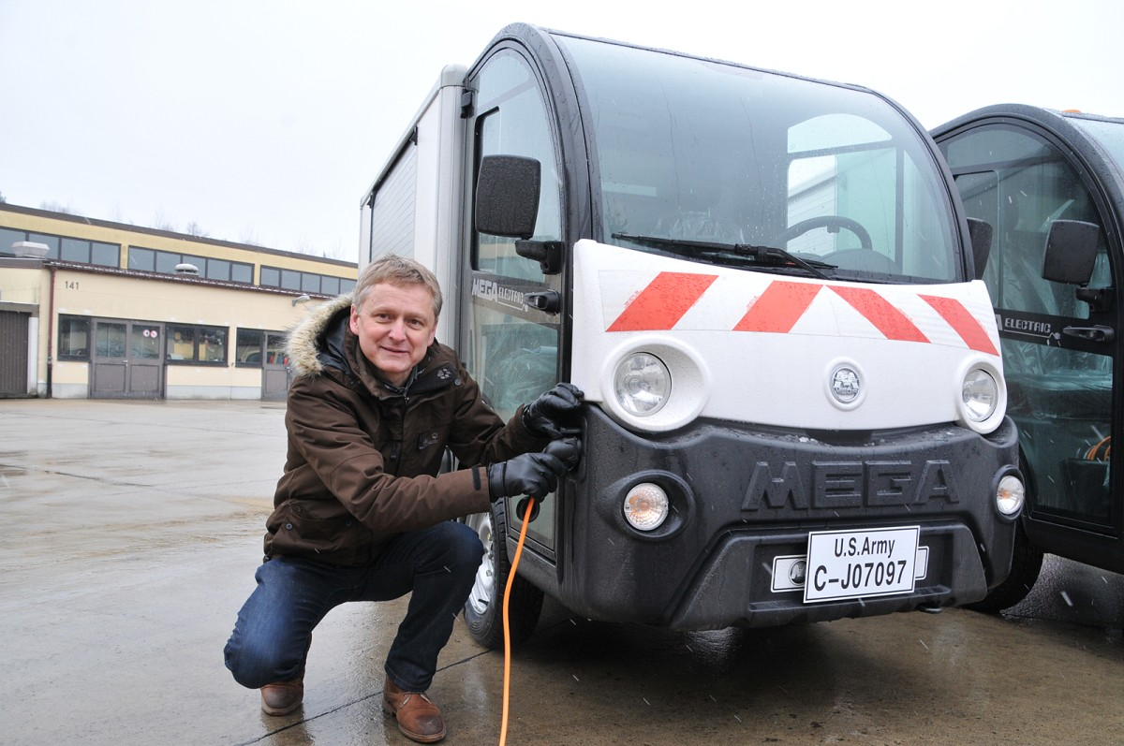
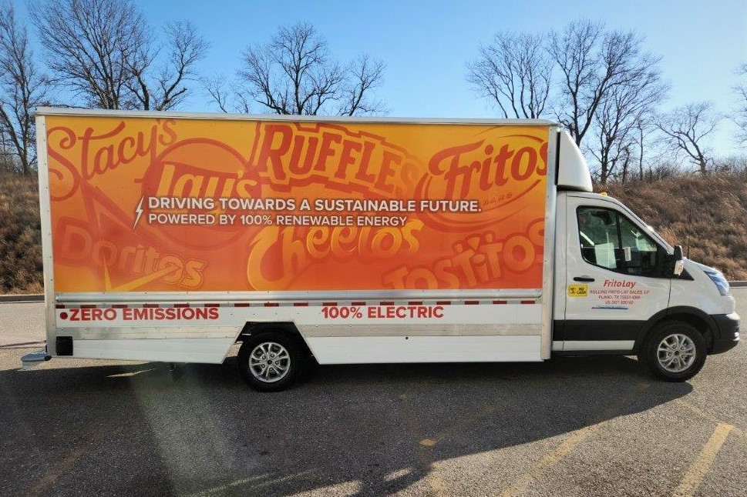
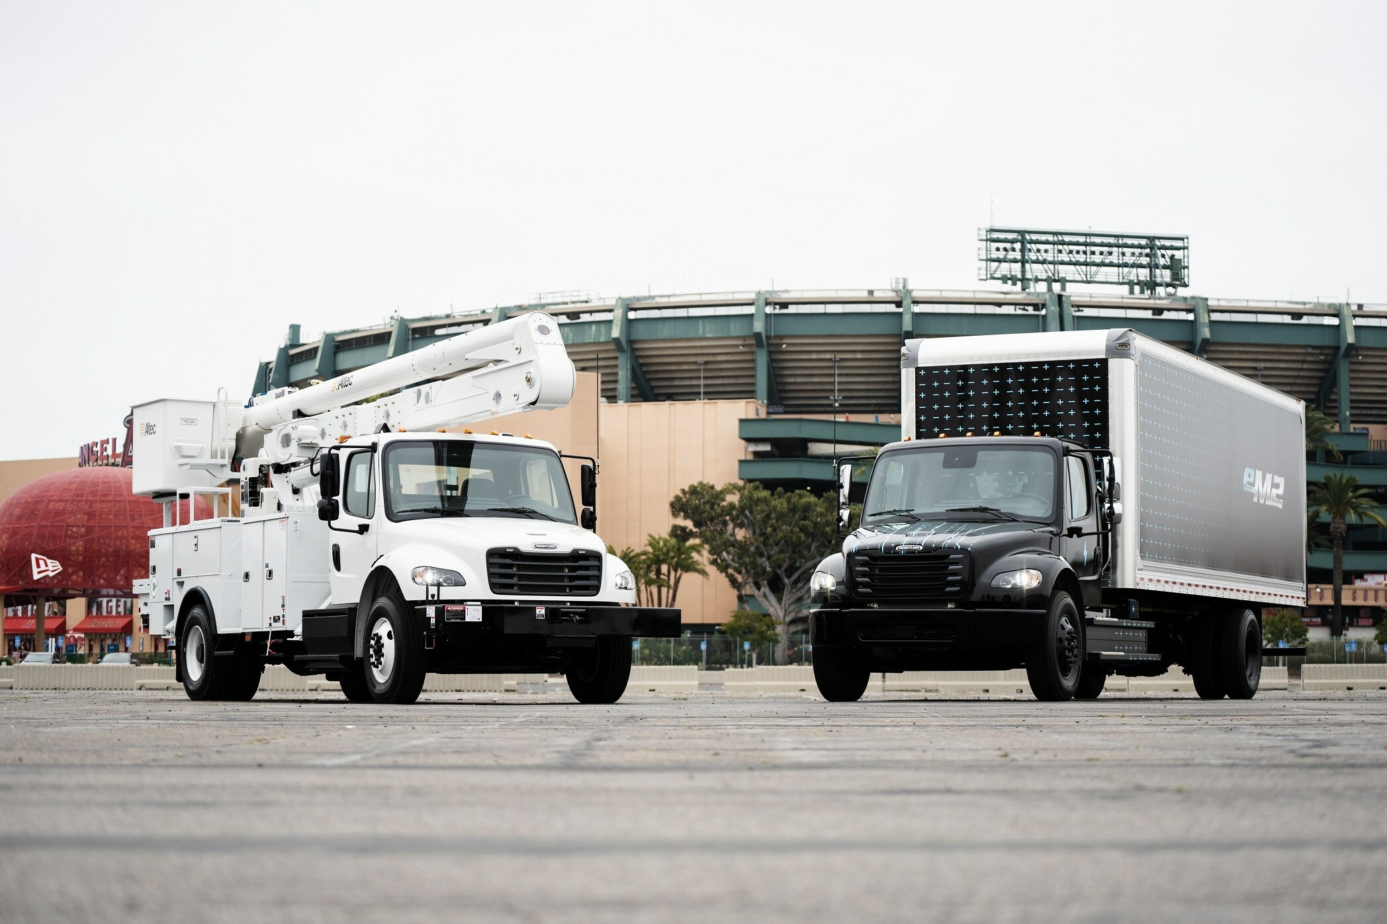
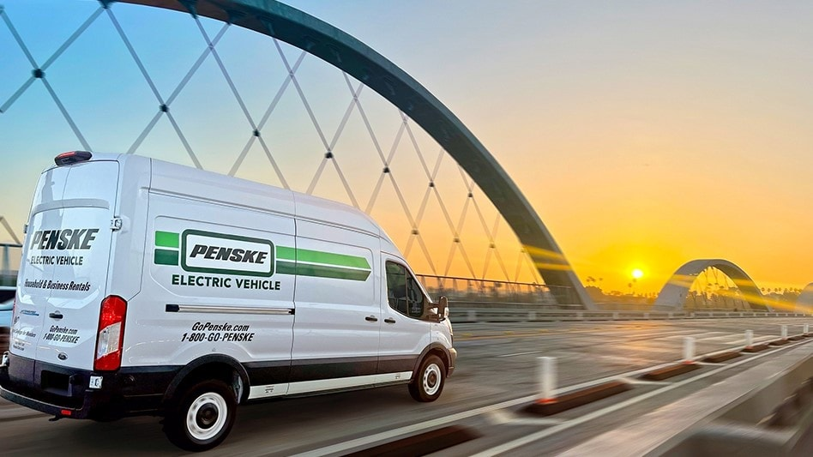

Slide 4
Charging Needs / Options
EV charging can be deployed based on your business needs
Residences
Multi-family dwellings
Workplaces
Local businesses and public areas

Slide 5
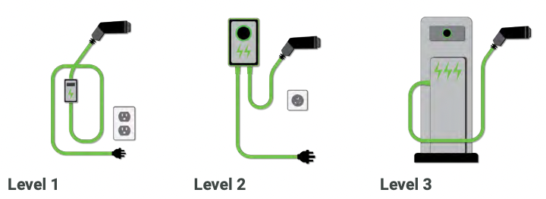
Flexible Charging Options for Fleet Needs
Level 1
Voltage: 120 V
Power: 1 - 1.4 kW
Level 2
Voltage: 240 V
Power: 3.9 - 19.2 kW
DCFC
Voltage: 120/208 or 480 DC
Power: 24 – 300+ kW

Slide 6
Sustainability and Quiet Operations
Zero emissions EVs eliminate tailpipe emissions that impact air quality and noise pollution.
Zero emissions benefit the communities that your fleet visits and serves.

Slide 7
Fleet Assessments
Ameren Illinois offers a fleet assessment tool they say demonstrates potential business impacts over 5 - 20 years. Contact Bill Reany, wreany@ameren.com
Argonne National Laboratory’s updated AFLEET analysis tool for examining both the environmental and economic costs and benefits of alternative fuel and advanced vehicles (AFVs). https://afleet.es.anl.gov/home/
Enterprise Fleet Management will do a fleet assessment as a part of conversation about working with them. Contact Broc McGuire, Brocton.McGuire@efleets.com

Slide 8
Total Cost of Ownership
Lower fuel and maintenance costs for EVs can generate savings over a vehicle’s useful life
With fewer moving parts compared to an internal combustion engine, EVs are easy to maintain, typically 40% cheaper to maintain, and can improve reliability
A range of federal grants, tax credits and other incentives can reduce costs for vehicles and charging infrastructure

Slide 9
Brands Saving with EVs
Anderson DuBosse: Reduced per-vehicle costs by $10,000 – enough savings to repay purchase costs before end-of-life
DHL: Cut fuel costs by more than 85%, generating $22,000 annual savings
Bolthouse Farms: Reduced their annual maintenance by 80%
Pepsico: Logged 15 million miles consuming less than 30% of the energy required by traditional trucks

Slide 10
Brands Electrifying Fleets
Benefits include:
Up to 75% less downtime and 80% lower repair costs
Fuel cost reduction of up to 90%
Cutting energy consumption by 30% or more
Reduced per-vehicle costs of $10,000+
Easy transition to more operable vehicles that are easier to maintain
Positive impacts to brand reputation

Slide 11
GRANTS – REBATES – INCENTIVES – TAX CREDITS
Federal (USDOE / USEPA / USDA)
State (IEPA / DCEO / IDOT)
Ameren Illinois Beneficial Electrification Plan
Vehicle / equipment
Grant cycles
Eligibility criteria / requirements / due date
Equipment specifications
Partnership requirements
Match dollar amounts

Slide 12
Illinois Utility Beneficial Electrification Plans
The Illinois Commerce Commission approved beneficial electrification plans filed by the two largest utilities in Illinois -- Ameren and Commonwealth Edison -- including more than $250 million in utility investments in electric vehicle charging infrastructure over the next three years.
The beneficial electrification plans were required the Illinois' Climate and Equitable Jobs Act (CEJA) that includes programs targeting transportation-related emissions, workforce development, and investments in charging infrastructure in disadvantaged communities.

Slide 13
EV and FCEV Federal Tax Credit Evolution
Link: https://afdc.energy.gov/laws/409

Slide 14
Federal Commercial EV and FCEV Tax Credit
January 1, 2023 through 2032
Tax credit calculated as the lesser of the following, up to the maximum amounts listed on next slide:
15% of the vehicle purchase price for PHEVs
30% of the vehicle purchase price for EVs and FCEVs
The incremental cost of the vehicle compared to an equivalent internal combustion engine vehicle.
Link: https://afdc.energy.gov/laws/409

Slide 15
Federal Commercial EV and FCEV Tax Credit Vehicle Eligability
New vehicles with a GVWR below 14,000 lbs must have a battery capacity of at least 7kWh
Maximum tax credit of $7,500
New vehicles with a GVWR above 14,000 lbs must have a battery capacity of at least 15kWh
Maximum tax credit of $40,000
Link: https://afdc.energy.gov/laws/409
https://afdc.energy.gov/laws/409

Slide 16
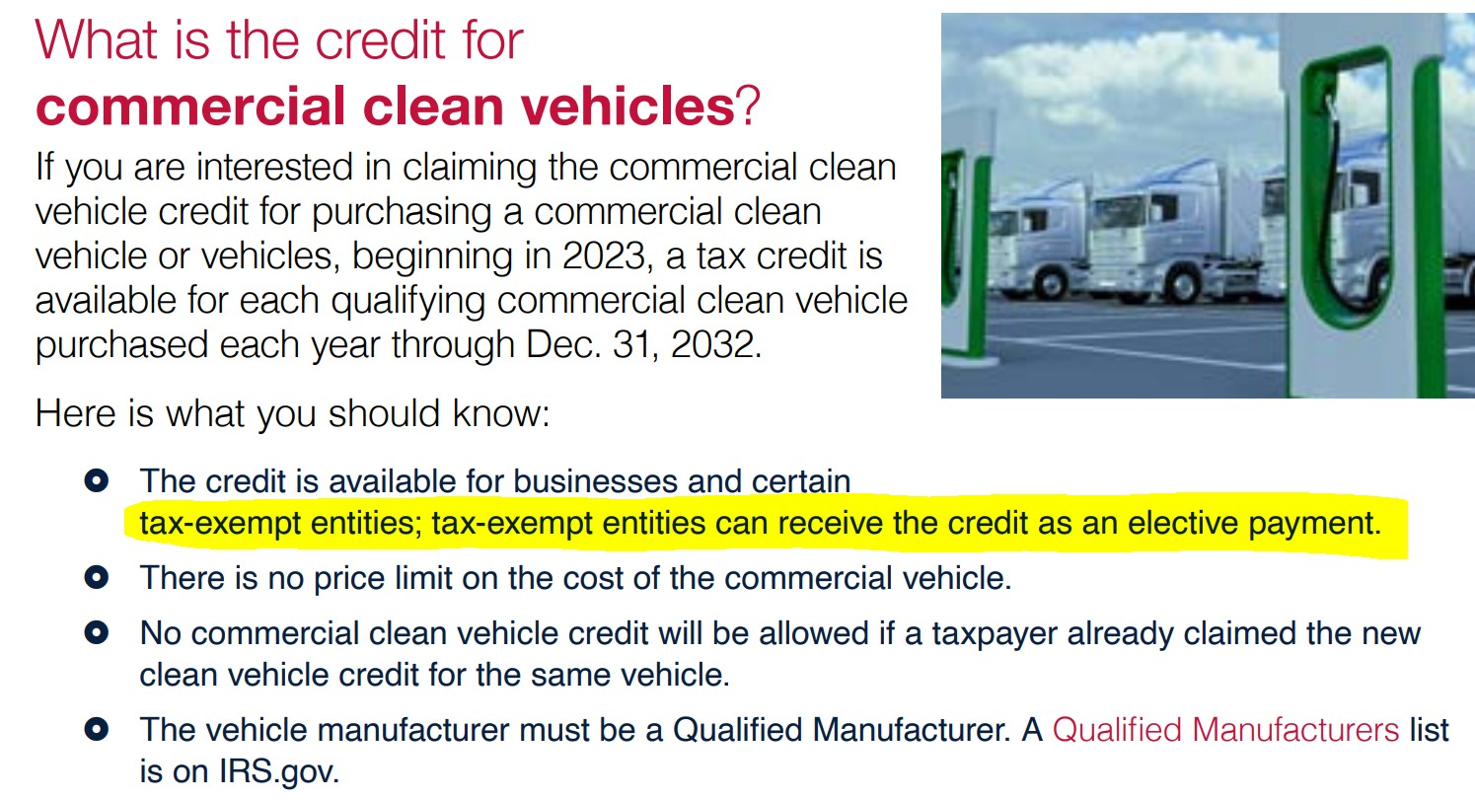
Federal Commercial EV and FCEV Tax Credit
Available for businesses and may not be combined with the individual Clean Vehicle Tax Credit
Additional requirements may apply. Further guidance if forthcoming.
Link: https://afdc.energy.gov/laws/409

Slide 17
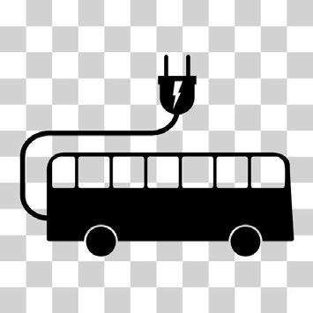
Illinois (VW) Environmental Mitigation Trust Fund
Established as part of the VW Settlement to address Clean Air Act violations related to certain Volkswagen diesel vehicles. Illinois received an initial allocation of approximately $108 million. The funds are to be used for projects that reduce nitrogen oxide (NOx) emissions in Illinois.
Up to $27,023,485 in Volkswagen funding is available for all-electric school buses. Applications are due on September 5, 2023. Funding is available for replacing old diesel school buses with new all-electric school buses. Pre-qualification is required before application submission.
Link: https://epa.illinois.gov/topics/air-quality/driving-a-cleaner-illinois/vw-settlement.html ; https://epa.illinois.gov/topics/air-quality/driving-a-cleaner-illinois.html
9

Slide 18
Driving Cleaner Illinois Grants, Round 5
Provided by Illinois EPA VW Mitigation Trust Funds
Over $27M now available to replace old, diesel school buses with new all- electric school buses
Applications due September 5, 2023
Class 4-6: $190,000 per school bus
Class 7-8: $250,000 per school bus
Infrastructure: $20,000 per location
Applicants must pre-qualify prior to application submission
Link: https://www2.illinois.gov/epa/topics/ceja/Pages/Electric-Vehicle-Rebates.aspx

Slide 19
Illinois Electric Vehicle Rebate Program
Provided by Illinois EPA $4,000 for the purchase of an all-electric vehicle, not an electric motorcycle
Beginning July 1, 2026: $2,000
Beginning July 1, 2028: $1,500
$1,500 for the purchase of an all-electric motorcycle
Link: https://www2.illinois.gov/epa/topics/ceja/Pages/Electric-Vehicle-Rebates.aspx

Slide 20
Illinois Electric Vehicle Rebate Program
Available from November 1, 2023 to January 31, 2024
Provided by Illinois EPA
Application and instructions October 18, 2023
Link: https://www2.illinois.gov/epa/topics/ceja/Pages/Electric-Vehicle-Rebates.aspx

Slide 21
Propane Vehicle Rebate Program
Provided by Illinois Propane Education & Research Council
$4,000 per new propane vehicle or vehicle converted to propane
Vehicle must be registered and operated in Illinois
Applications accepted January 1, 2023 through December 31, 2023
First come, first served while funds last
Link: https://ilsaveswithpropane.com/rebate-program/propane-vehicle-incentives/
13

Slide 22
Current and Proposed Timelines (what & when)
Diesel Emissions Reductions Act (DERA)
FY2022/2023 Combined NOFO – Inflation Reduction Act (IRA)
-$3B Clean Ports- (TBD)
July 2023
-$1B Medium- and Heavy-Duty Vehicles - (TBD)
-RFI for both programs open until
June 5
Bipartisan Infrastructure Law (BIL) $5B Clean School Bus program
-2023 BIL CSB Grant Program –
NOFO NOW OPEN April 24 to August 22
-2023 BIL CSB Rebate Program – Fall 2023*
EPA Ports Program: https://www.epa.gov/ports-initiative
EPA Medium- and Heavy-Duty Clean Truck Program: https://www.epa.gov/inflation-reduction-act/clean-heavy-duty- vehicle-program

Slide 23
Diesel Emission Reduction Act (DERA) Funds
•
Application due December 1, 2023. Participating states can support grant, rebate, and loan programs to achieve significant reductions in diesel emissions. States enter into Cooperative Agreements with the U.S. Environmental Protection Agency to administer their allocation of DERA funds for eligible project types.
•
NGOs doing transportation / air quality work can apply on behalf of fleets
Link: Diesel Emission Reduction Act (DERA)

Slide 24
DERA: What will EPA Fund?
Certified Engine Replacement:
40% of a diesel or alternative fueled engine (including hybrids) certified to EPA emission standards
50% of the cost of an engine certified to meet CARB’s Optional Low-NOx Standards
60% of the cost of a zero tailpipe emission power source
Verified Idle Reduction Technologies:
On-Highway Idle Reduction Technologies: 100% if combined*, 25% if stand-alone.
Locomotive Idle Reduction Technologies: 40%
Marine Shore Connection Systems: 25%
Electrified Parking Spaces: 30%
Clean Alternative Fuel Conversion: 40%
Certified Vehicle/Equipment Replacement:
25% of a vehicle powered by a diesel or alternative fueled engine (including hybrids) certified to EPA emission standards;
35% of a vehicle powered by an engine certified to meet CARB’s Optional Low-NOx Standards;
45% of a vehicle powered by a zero tailpipe emission power source.
Replacement of Drayage Trucks: 50%

Slide 25
Clean School Bus Rebates and Grants (closed)
https://www.epa.gov/cleanschoolbus/clean-school-bus-program-grants

Slide 26
FY23 Clean School Bus Grants NOFO Important Dates
April 24, 2023 | Notice of Funding Opportunity (NOFO) Opened
May 10, 2023 at 3:00 p.m. (ET) | 1st Webinar Information Session Webinar links and additional session dates can be found at: www.epa.gov/cleanschoolbus/clean-school-bus-program-grants
August 9, 2023 | Final Date to Submit Questions
August 22, 2023 at 11:59 p.m. (ET) | NOFO Closes – Application Deadline Application packages must be submitted electronically to EPA through Grants.gov (www.grants.gov) no later than Tuesday, August 22, 2023, at 11:59 p.m. Eastern Time (ET) in order to be considered for funding
November 2023 to January 2024 | Anticipated Notification of Selection
February to March 2024 | Anticipated Awards
Application packages must be submitted to EPA via Grants.gov no later than 8/22/23 at 11:59 p.m. ET. For more information, please visit www.epa.gov/cleanschoolbus.

Slide 27
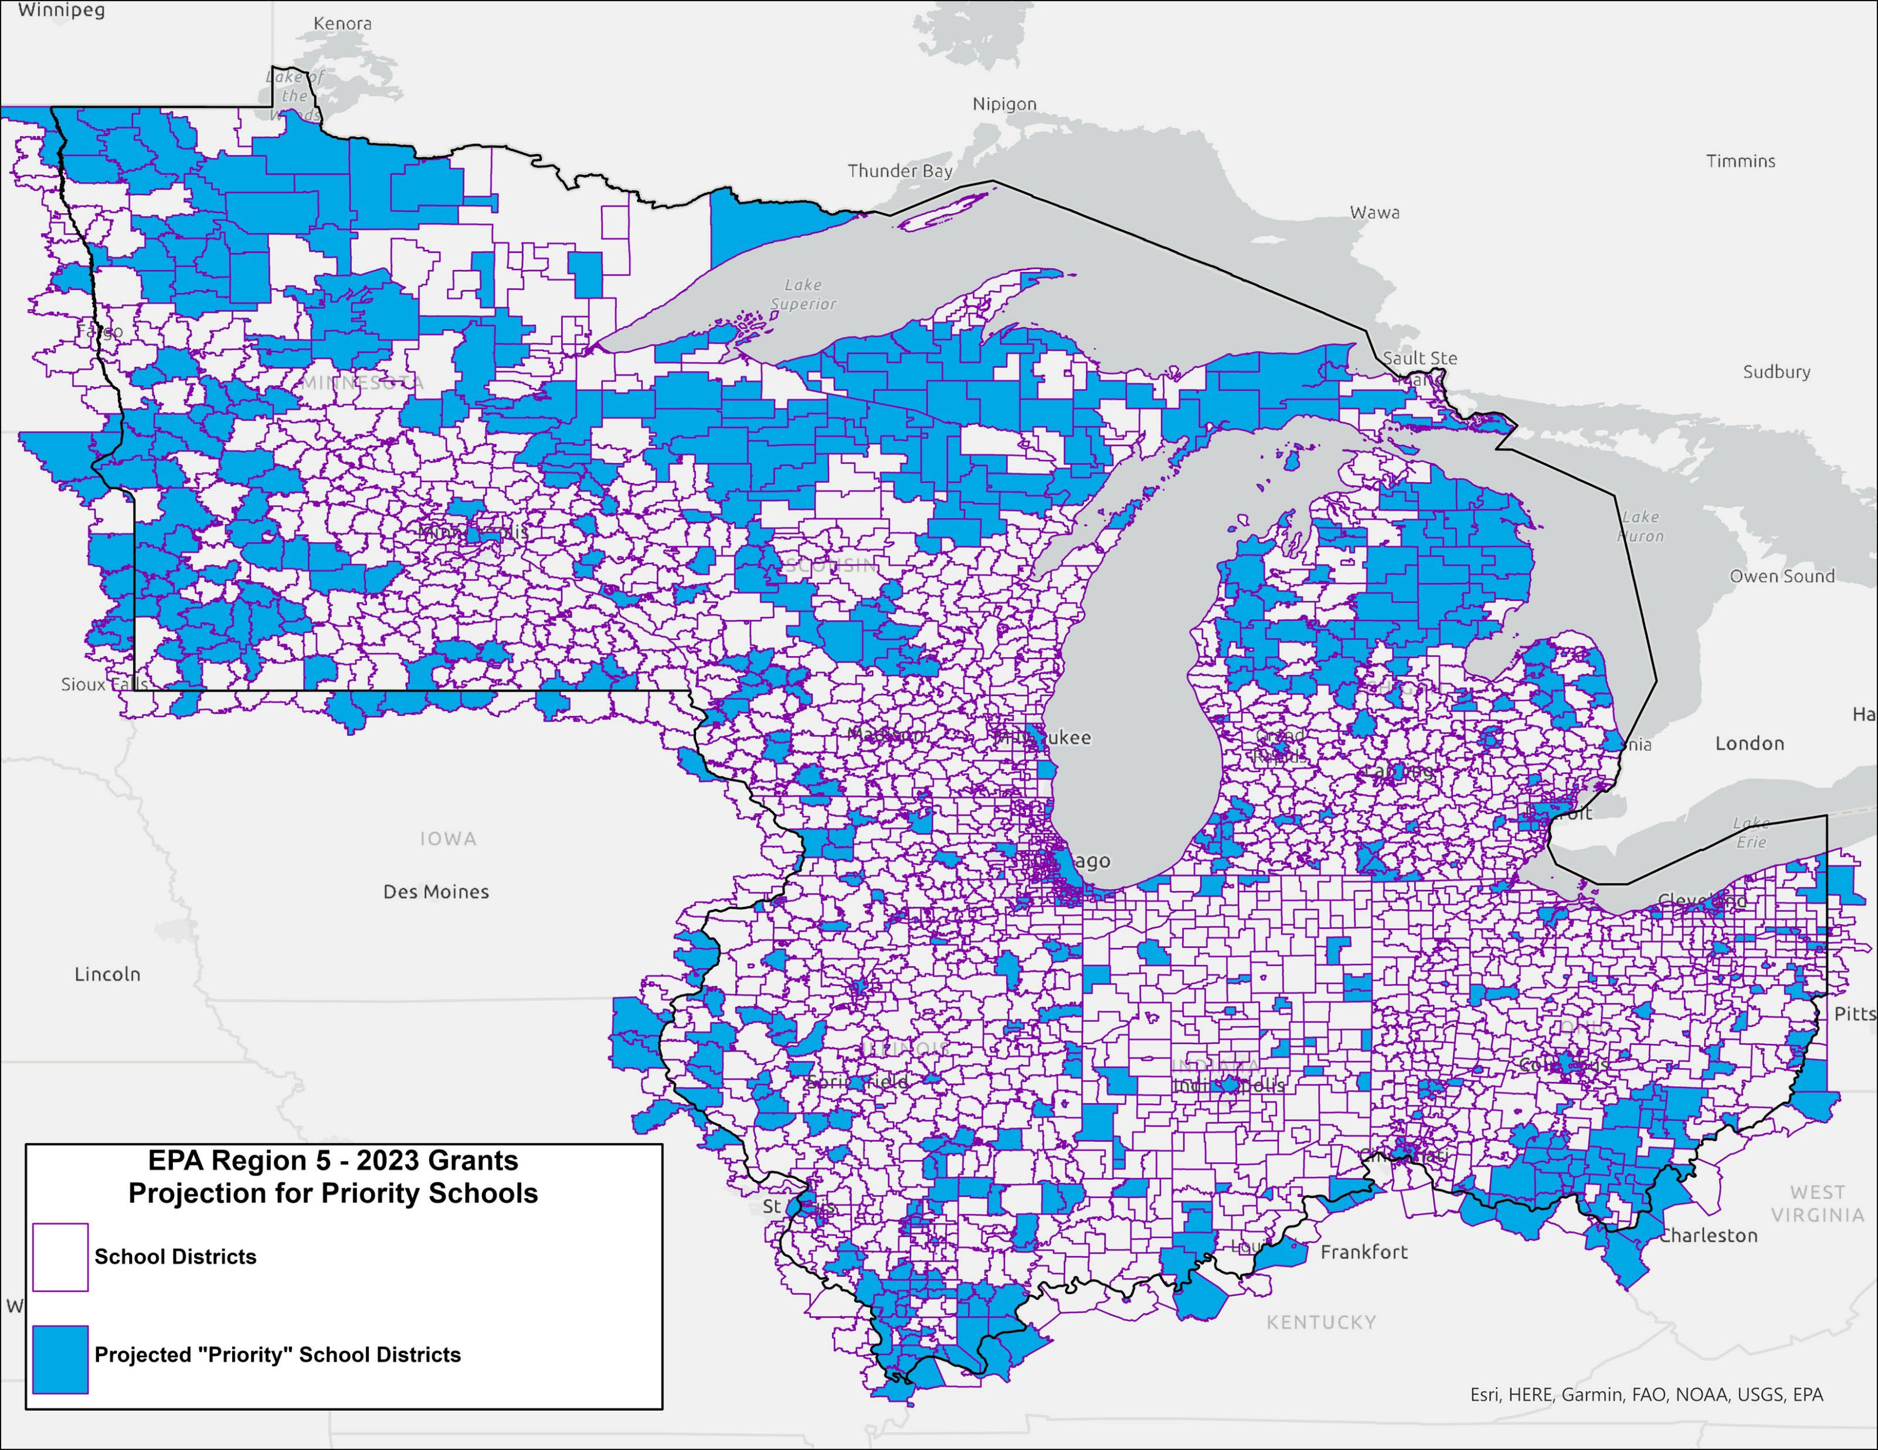
Prioritization Criteria
2023 CSB Grants
Priority School Districts PDF and Excel files available at: https://www.epa.gov/cleanschoolbus/c lean-school-bus-program-grants

Slide 28
INFRASTRUCTURE PROGRAMS AND FUNDING
ELECTRIC AND NON-ELECTRIC ALTERNATIVE FUELS

Slide 29
USDA Higher Blends Incentive Program
Purpose: to increase significantly the sales and use of higher blends of ethanol and biodiesel by expanding the infrastructure for renewable fuels derived from U.S. agricultural products.
Who may apply: Transportation fueling faciliti•esFuelu-neutral to help their stakeholders i
Fueling stations, convenience stores, hypermarket fueling stations, fleet facilities (including rail and marine), and similar entities with capital investments;
Fuel distribution facilities, such as: Terminal operations, depots, and midstream partners, and similarly equivalent operations.
incl
ding:
•
Home heating oil distribution facilities

Slide 30
USDA Higher Blends Incentive Program
What Funding is Available: Under HBIIP, approximately
$90 million per quarter
to:
Fueling stations, convenience stores, hypermarket fueling stations, fleet facilities, and similar entities with capital investments) for eligible implementation activities related to higher blends of fuel ethanol greater than 10 percent ethanol, such as E15 or higher, and biodiesel greater than 5 percent biodiesel, such as B20 or higher; and
Terminal operations, depots, midstream partners, and home heating oil distributors for eligible implementation activities related to higher blends of fuel ethanol greater than 10 percent ethanol, such as E15 or higher, and biodiesel greater than 5 percent biodiesel, such as B20 or higher.

Slide 31
USDA Higher Blends Incentive Program
What are the terms: Awards to successful applicants will be in the form of cost-
share grants for up to of total eligible project costs, but not to exceed $5M, whichever is less.
75%
Links: HBIIP webpage, Federal Register, Grants.gov, Inflation Reduction Act, USDA Rural Development

Slide 32
Alternative Fuel Infrastructure Federal Tax Credit Evolution
Link: https://afdc.energy.gov/laws/10513

Slide 33
Alternative Fuel Infrastructure Federal Tax Credit Evolution
Federal Commercial EV and FCEV Tax Credit
TAX CREDIT AMOUNTS
• Beginning January 1, 2023 through 2032
• Tax credit calculated as the lesser of the following, up to the maximum amounts listed on next slide:
• 15% of the vehicle purchase price for PHEVs
• 30% of the vehicle purchase price for EVs and FCEVs
• The incremental cost of the vehicle compared to an equivalent internal combustion engine vehicle.
Link: https://afdc.energy.gov/laws/10513

Slide 34
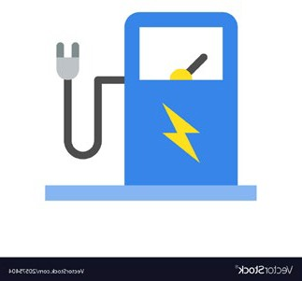
National Electric Vehicle Infrastructure Program
Formula program: $5 billion to states; $148 million to Illinois
Initially, funding under this program is directed to designated Alternative Fuel Corridors
–
stations every 50 miles
and no more than 1 mile off the designated corridor
•
Public Charging
= stations available to the public 24 hours a day, 7 days a week
At minimum,
4 vehicles
will be charge at the same time, at a charging speed that
will fully charge an average EV in under a half hour
Prioritize Justice 40 communities

Slide 35
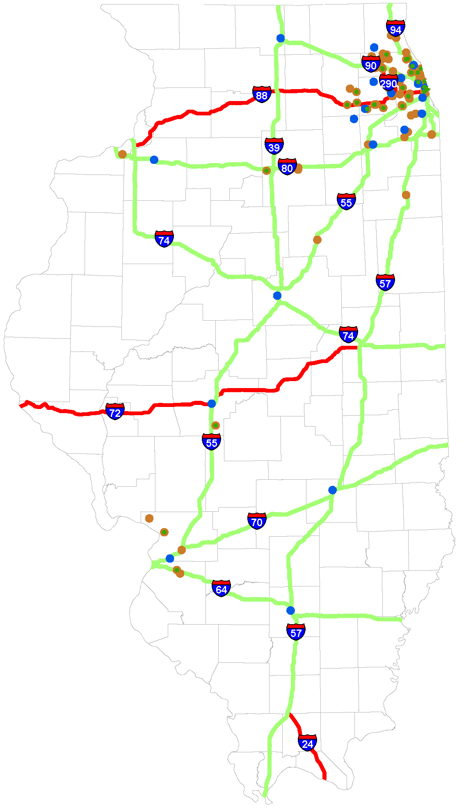
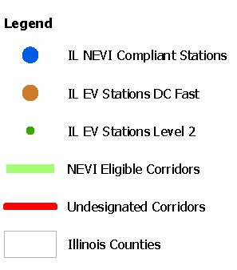
Illinois Alternative Fuel Corridors
Electric Vehicle Signage Ready
I-39 from Rockford IL to Sun Prairie WI
I-55 from Chicago IL to Bolingbrook, IL
I-74 from IL/IA border to IL/IN border
I-80 from IL/IN border to Joliet IL
I-90 from IL/IN border to Sun Prairie WI; and, from La Crosse WI to Sparta WI
I-94 from Sun Prairie WI to IL/IN border
Electric Vehicle Signage Pending
I-39 from Normal IL to Rockford IL
I-55 from Joliet IL to St. Louis
I-80 from Joliet IL to IL/IA border
I-70 from St. Louis to Indiana boarder
I-57 from Chicago to Missouri border
I-64 from St. Louis to Indiana boarder

Slide 36
Program Timeline
July 28, 2022- NEVI public meeting #1
August 1, 2022- Illinois submitted NEVI plan to Federal Highways
August 22, 2022- Comment period closed on Notice of Proposed Rulemaking for NEVI minimum standards and requirements
September 9, 2022- NEVI public meeting #2
September 27, 2022- Federal Highway Administration approved Illinois NEVI plan
November 29, 2022- NEVI public meeting #3
February 2, 2023- IDOT Releases RFP for project manager for NEVI in Illinois
February 28, 2023- NEVI Final Rule
March 2023- Release of solicitation for project manager
April 2023- Hired consultant to run NEVI
May 2023- Release of Request for Information (RFI)
Next Steps:
–
– New NEVI plan due in August
Develop NEVI Grant Program

Slide 37
Discretionary Grant Program for Charging and Fueling Infrastructure
For EV charging, hydrogen, propane, and natural gas fueling infrastructure
Divided into two distinct $1.25 billion grant programs to support EV charger deployment
Eligible entities include states, local governments, MPOs, etc.
–
Corridor Charging Grant Program
Strategically deploy publicly accessible EV charging infrastructure and alternative fueling infrastructure along designated Alternative Fuel Corridors
–
Community Charging Grant Program
Strategically deploy publicly accessible EV charging infrastructure and alternative fueling infrastructure in communities
driveelectric.gov

Slide 38
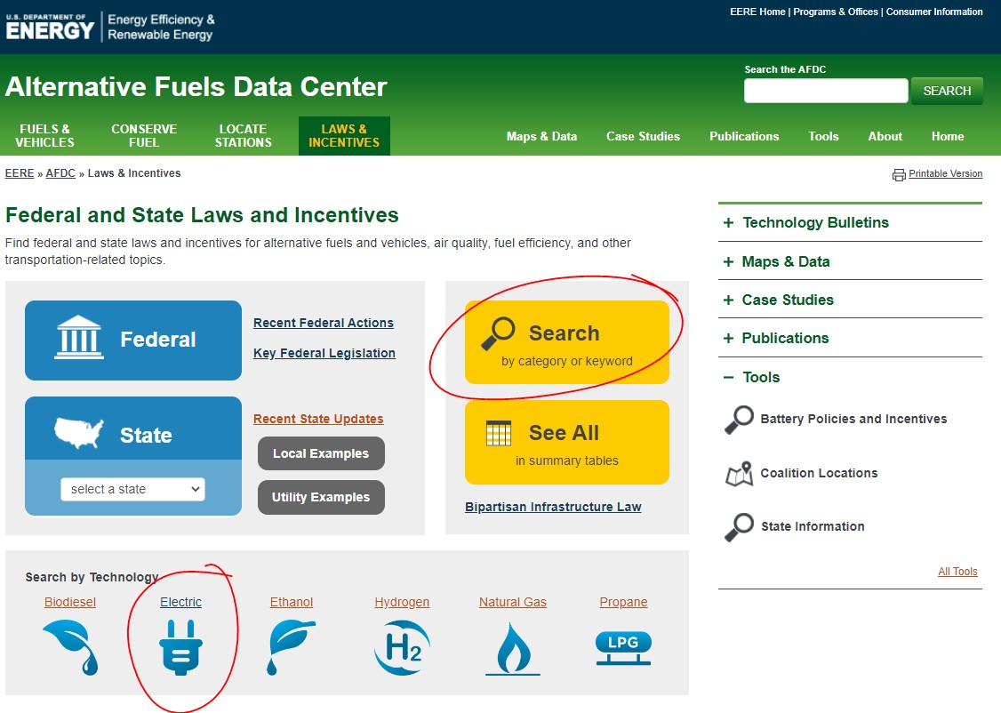
How to Keep Informed About Funding Opportunties
No one-stop shop
IACT’s website,
funder websites / site list-serv, weekly email,
social media;
conferences
Link: https://afdc.energy.gov/

Slide 39
Illinois Alliance for Clean Transportation
Upcoming Event
By October 6, please nominate an Illinois company or individual who has accomplished something of significance this year that reduced transportation emissions through the use of alternative fuels (including EV). See hand out.
IACT Annual Meeting and Awards Dinner
Danada House, 3S501 Naperville Road, Wheaton.
Dec 6, 4:00 PM – 7:00 PM
IACT members and annual sponsors receive free tickets.

Slide 40
Illinois Alliance for Clean Transportation
Learning Events
Spring Green Drives Conference and Expo – Chicago Region – May 2024 @ Powering Chicago
Summer 2024 Green Drives Conference and Expo – Southern Illinois Region - TBA

