Slide 1
Solar Energy
The Tale of an Actual User
Mark Steinmetz

Slide 2
Solar Energy
About the System
Considerations
Size
Location
Cost Analysis and Payback
Research
Production Annual / Monthly Average %
Things to consider
Takeaways

Slide 3
Solar Energy
Commissioning Date; February 15^{th,} 2017
32 Panels - Trina Solar – 335w each– DC
Added 4 additional panels 4/30/2018 for a total of 36
Increased to 12.0 kW
Inverter – Fronius 10kw inverter
Ground Mount

Slide 4
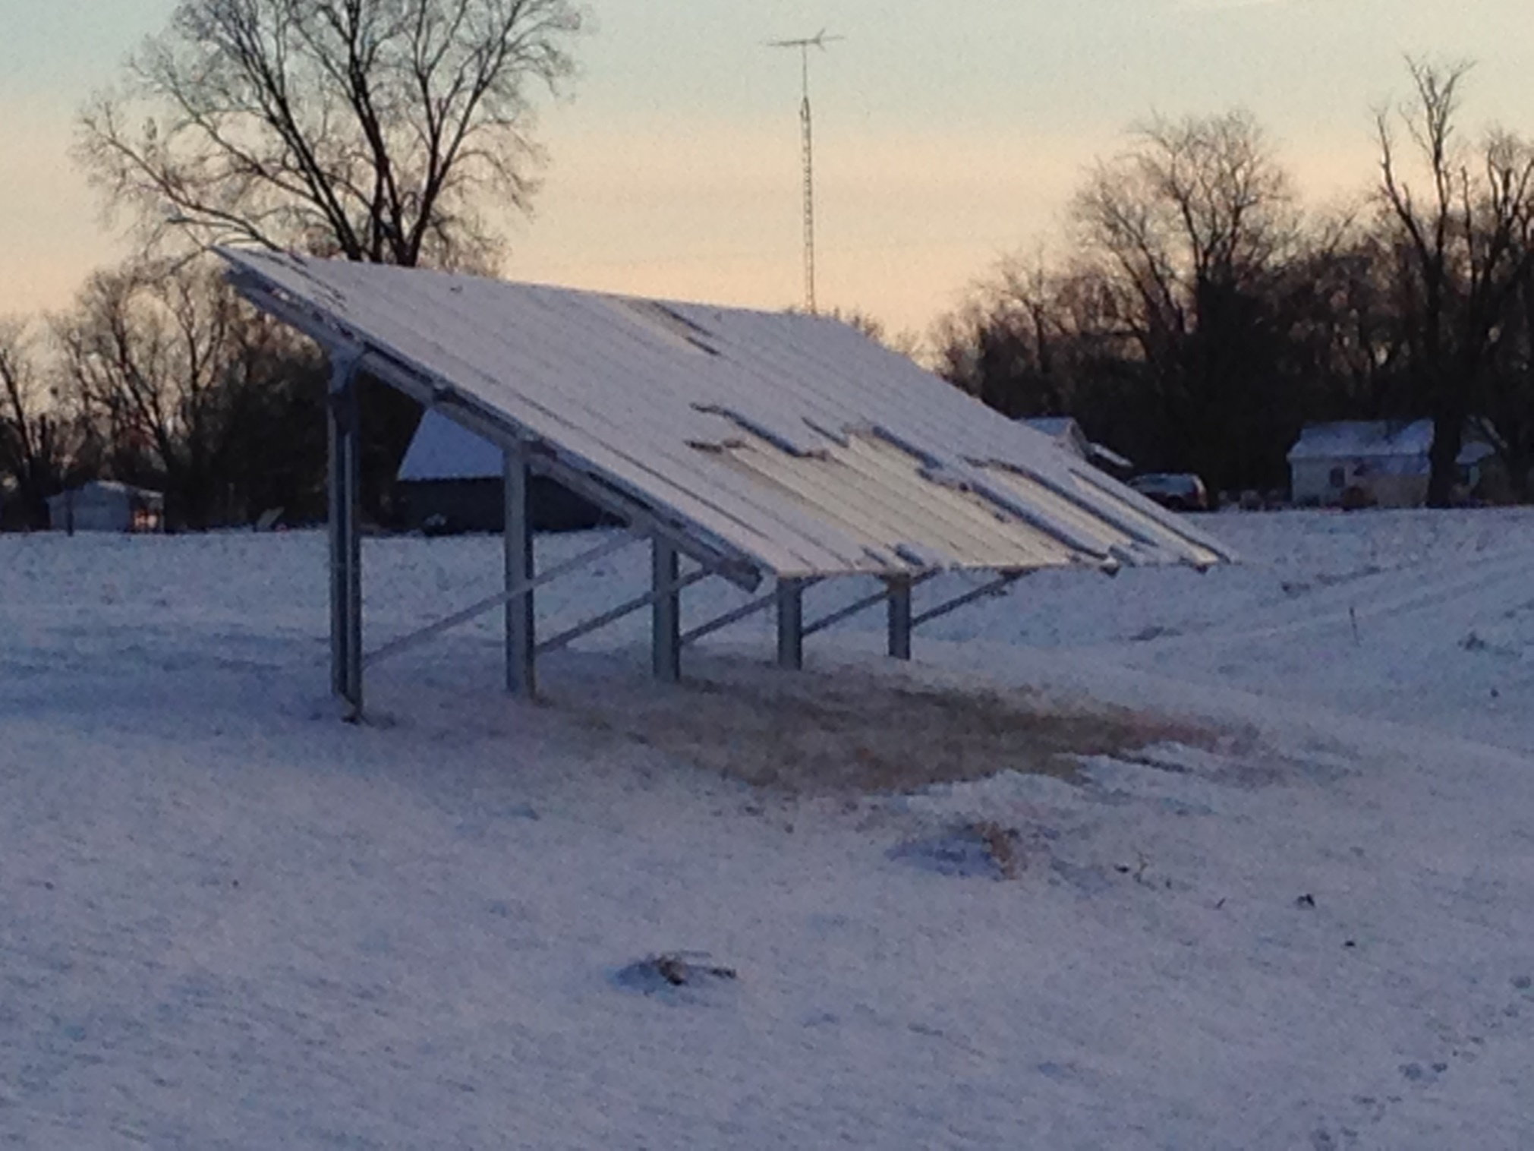
Solar Energy

Slide 5
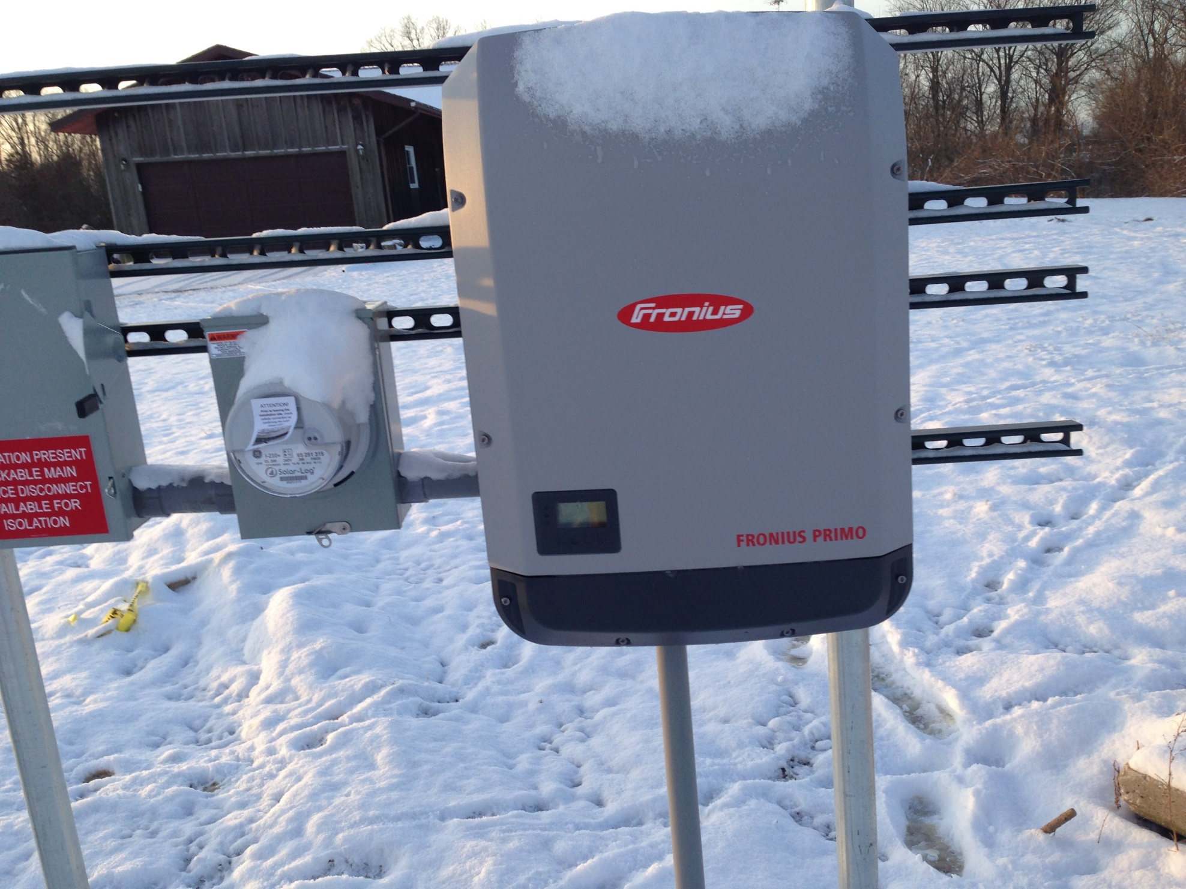
Solar Energy

Slide 6
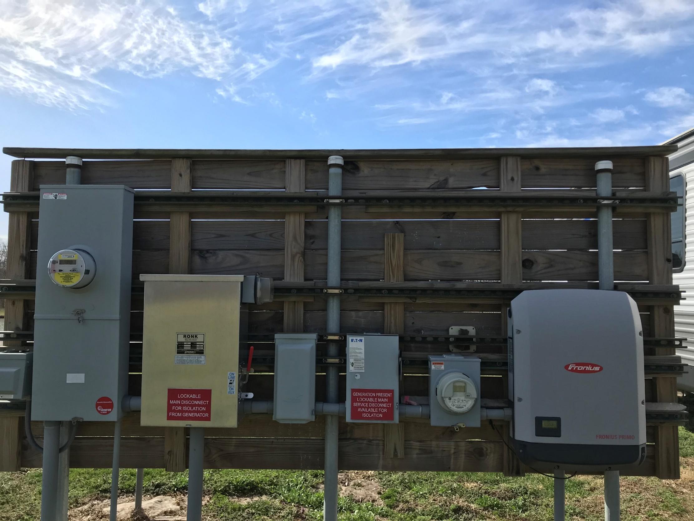
Solar Energy

Slide 7
Solar Energy
Initial Cost Installed $25,000.00
Estimated Annual Production 15,000 kW
Federal Tax Credit @ 30% $7500.00
Solar Renewable Energy Credits
Estimated at 40% of project $10,000.00
Estimated Annual Energy cost savings $ 1,650.00
Estimated simple payback period 4.7 years
Estimated after panel add 4.3 years

Slide 8
Solar Energy
Research
National Renewable Energy Laboratory - PVWatts Calculator
https://pvwatts.nrel.gov/
Schuler County Hwy Dept.
Schuyler Co. Hwy. Dept. Plant overview (sunnyportal.com)
Commissioned: June 02, 2011
108,736 kWhs produced

Slide 9
Solar Energy
Production
Total 66,734 kWhs - 4 years
Average annual production
16,390.25 kW

Slide 10
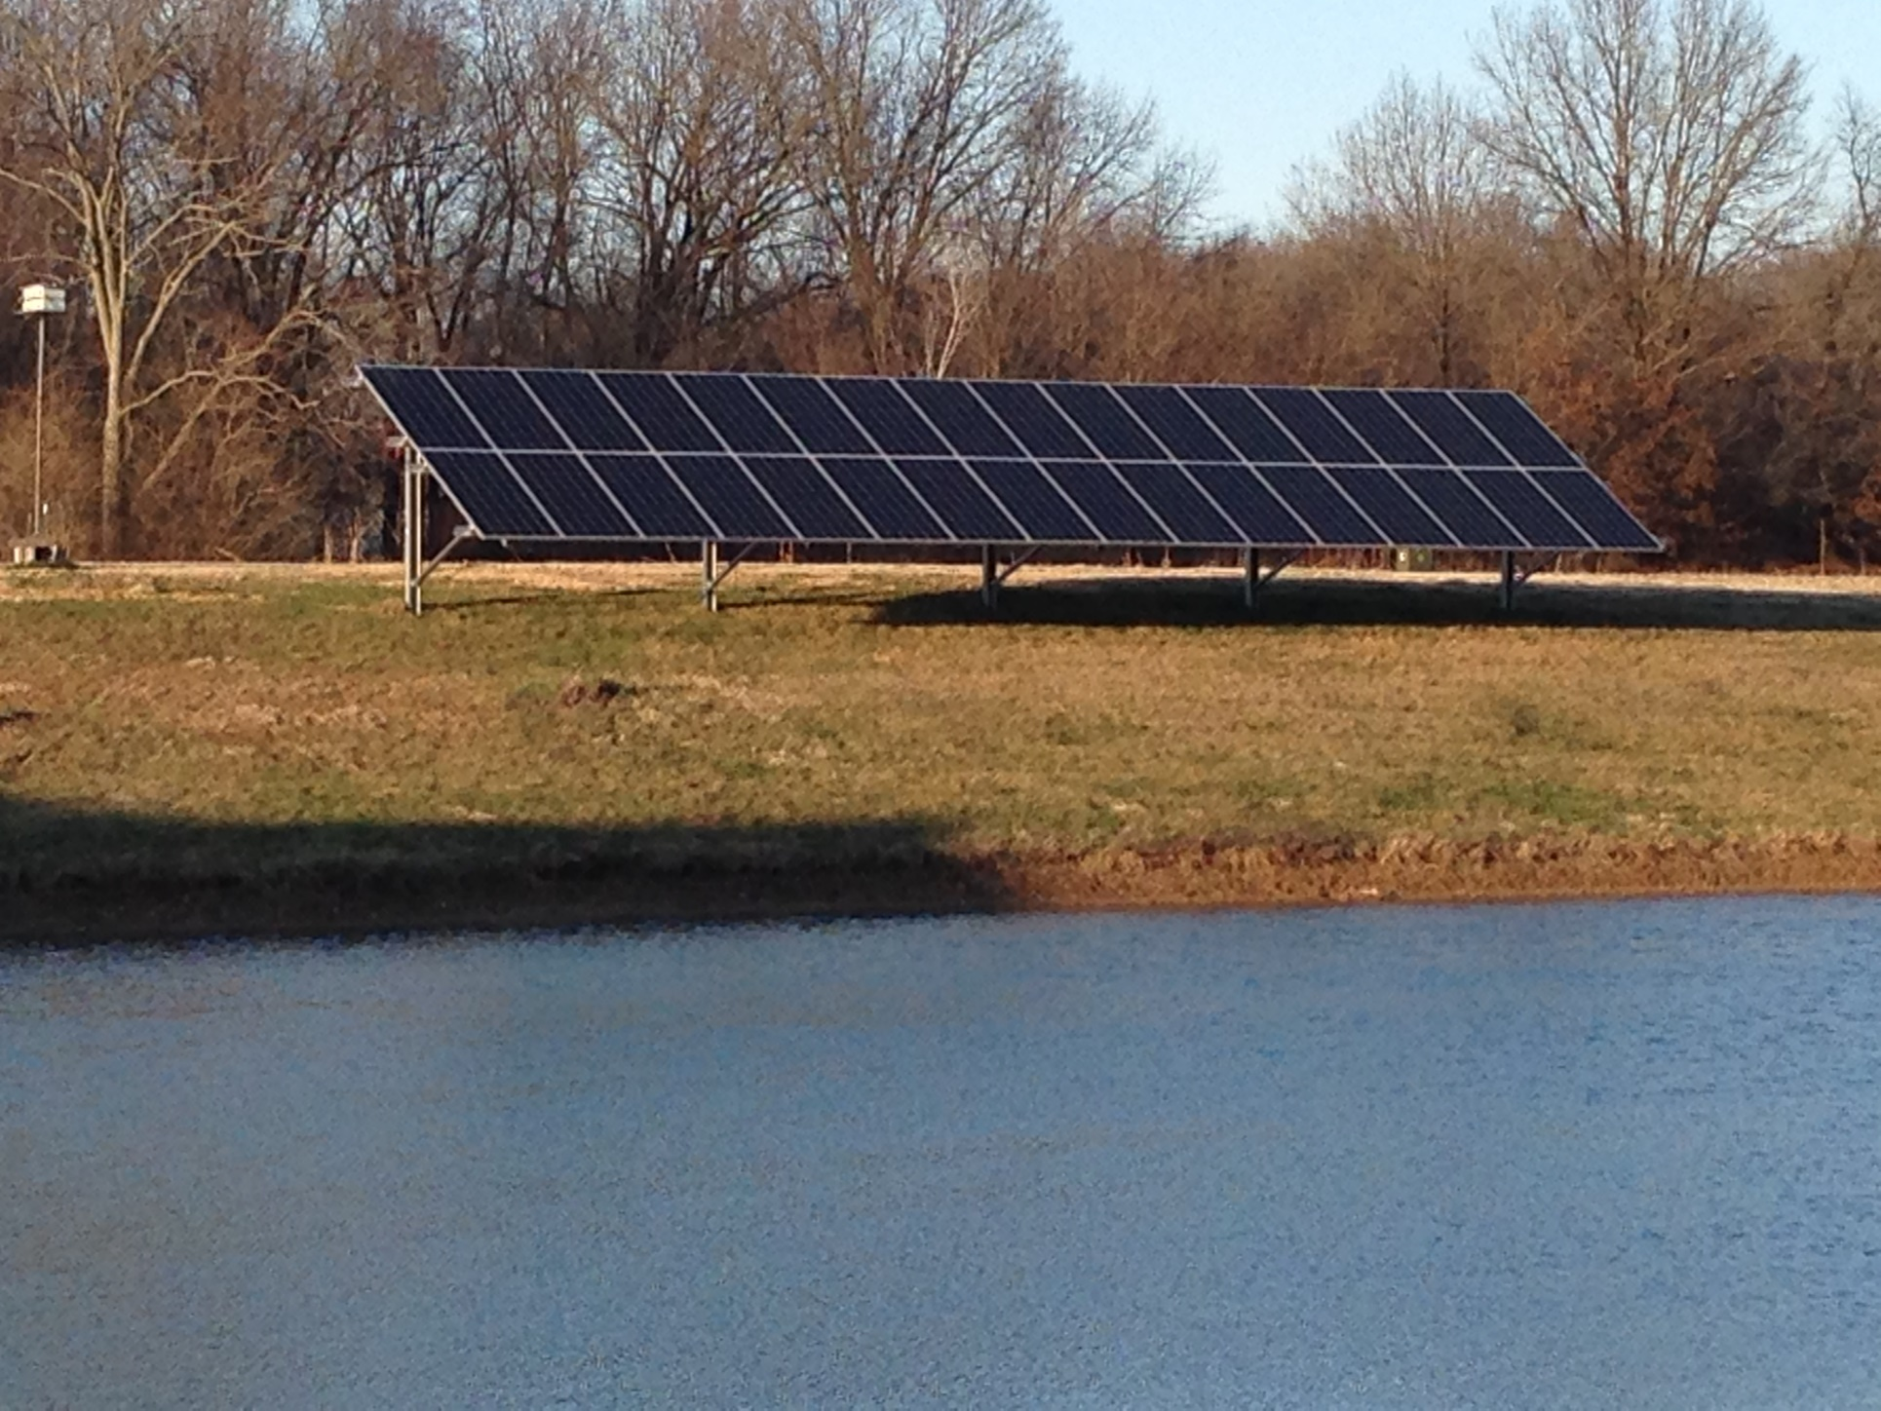
Solar Energy
Location Considerations

Slide 11
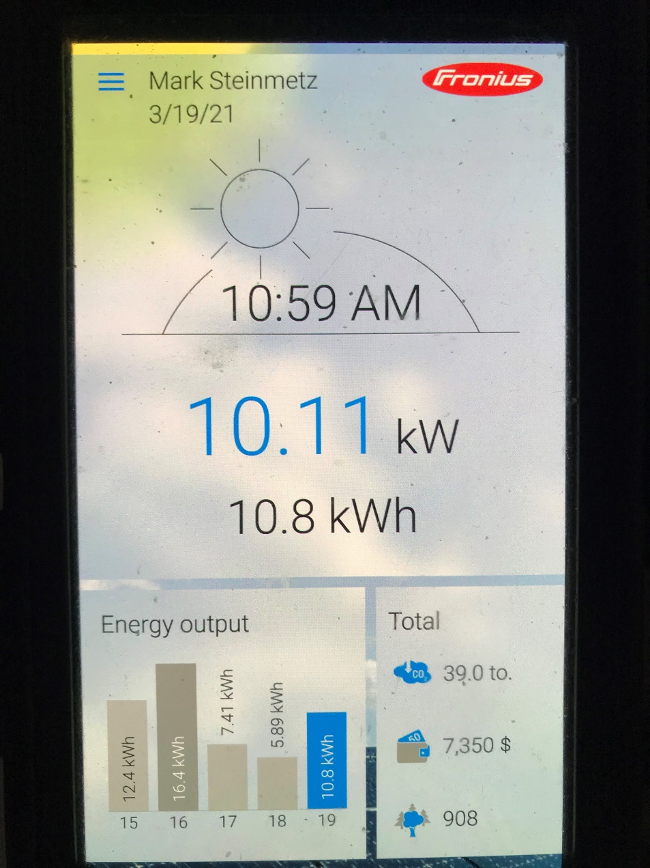
Solar Energy
Production
Percent of annual production
January 6%
February 5%
March 8%
April 8%
May 10%
June 11%
July 11%
August 10%
September 10%
October 7%
November 7%
December 6

Slide 12
Solar Energy
Items to think about
Is your home or facility Energy Efficient?
What size system?
Where would I locate the array?
What would be my cost per watt?
Does my utility have a net-metering program?
Are there SREC’s available?
Are there any incentives available from the Utility?
No residential incentives, IPA handles SREC’s
Ameren has incentives for Smart Inverters for commercial accounts.

Slide 13
Solar Energy
Key Takeaways
Always look to energy efficiency projects first!
Consistent savings and lower usage regardless of source
Compare pricing and use a metric of, “cost per watt”
Source from a trusted provider
Low maintenance
In Illinois – they should not increase property tax value

Slide 14
Solar Energy
67,040 kWhs to date
Equivalent to CO2 reduction
10.2 Passenger vehicles driven for 1 year
5,334 Gallons of gasoline consumed
52,228 lbs. of coal burned
1801 incandescent lamps switched to LED
47.4 metric tons of Carbon Dioxide

Slide 15
Solar Energy
Questions

